Slide 1
The Geopolitics of Peace
In a Post-Western World
Jeffrey D. Sachs
University Professor at Columbia University
Allama Iqbal Lecture
Oxford University
March 2, 2023

Slide 2
International Relations Theory should have as its core aim not only the description of the causes of war but the prescription of the paths to peace

Slide 3
The world is very different now. For man holds in his mortal hands the power to abolish all forms of human poverty and all forms of human life. JFK January 20, 1961

Slide 4
The Tragedy of Realism:
Great Power Conflict

Slide 5
The sad fact is that international politics has always been a ruthless and dangerous business, and it is likely to remain that way. Although the intensity of their competition waxes and wanes, great powers fear each other and always compete with each other for power. The overriding goal of each state is to maximize its share of world power, which means gaining power at the expense of other states. But great powers do not merely strive to be the strongest of all the great powers, although that is a welcome outcome. Their ultimate aim is to be the hegemon—that is, the only great power in the system. (Kindle, p. 22)

Slide 6
Three features of the international system combine to cause states to fear one another: 1) the absence of a central authority that sits above states and can protect them from each other, 2) the fact that states always have some offensive military capability, and 3) the fact that states can never be certain about other states’ intentions. Given this fear—which can never be wholly eliminated—states recognize that the more powerful they are relative to their rivals, the better their chances of survival. Indeed, the best guarantee of survival is to be a hegemon, because no other state can seriously threaten such a mighty power. (Kindle p. 23)

Slide 7
Since no state is likely to achieve global hegemony, however, the world is condemned to perpetual great-power competition. (Kindle p. 23)

Slide 8
Categories of War
Imperial Plunder
Great Power Wars
Inter-Ethnic Conflict

Slide 9
Wars of Imperial Plunder:
British Conquest of India
European Conquest of Africa
United States Destruction of Native American Nations

Slide 10
Great Power Wars (Wars of Hegemony)
Athens and Sparta
World War I
World War II
Vietnam War (Proxy War)
Ukraine War (Proxy War)

Slide 11
Inter-Ethnic Wars:
Israel - Palestine
Ethiopia
India-Pakistan Wars

Slide 12
Wars of plunder are wars of the strong versus the weak. These are wars of injustice.
Wars of great powers are wars of the strong versus the strong. These are wars of competition.
Wars of inter-ethnic conflict are wars of the weak versus the weak. These are wars of fear.

Slide 13
Technological Divergence Leads to Wars of Plunder
Technological Convergence Leads to Wars of Competition
Shared Vulnerability Leads to Wars of Fear

Slide 14
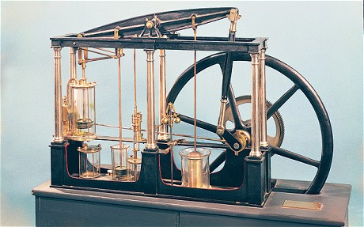
The Great Engine of 19th Century Divergence

Slide 15
GDP OF ASIA AND NORTH ATLANTIC REGIONS, 1820 - 2019

Slide 16
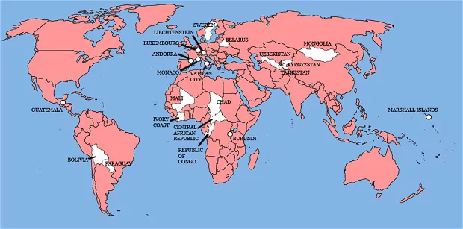
“Liberal Hegemony”
22 COUNTRIES NEVER INVADED BY BRITAIN
All the Countries We’ve Ever Invaded: And the Few We Never Got Round To, Stuart Laylock, 2012

Slide 17
Two Main Solutions to Wars of Plunder
Technological Convergence (strengthen the weak)
Collective Security (protect the weak from the strong)

Slide 18
The End of European Imperial Rule
Led to the
Global Shift from Divergence to Convergence

Slide 19
Fundamental Reasons for the Age of Convergence:
Independent states introduced education
Accelerating diffusion of technology
Equalizing deterrence (e.g., nuclear weapons)

Slide 20
In the 21st Century, major powers can still defeat weaker nations but can rarely subdue them:
Algeria
Vietnam
Afghanistan
Iraq
Libya
Syria

Slide 21
Technological Convergence Reduces Wars of Plunder
But Can Also Lead to
More Great Power Conflicts

Slide 22
Rising Powers Fear They Will Be Held Back By
Incumbent Powers
Incumbent Powers Fear They Will Be Overtaken by Rising Powers
Wars Among Want-to-Be Hegemons are the Most Insidious

Slide 23
The Thucydides’ Trap Theory
Of Competing Hegemons

Slide 27
THE US-RUSSIA STRATEGIC DILEMMA IN UKRAINE
(OR US-CHINA IN TAIWAN)
 | De-escalate | Escalate
De-escalate | 5,5 | -10,10
Escalate | 10,-10 | -5,-5
RUSSIA
USA

Slide 28
THE US-RUSSIA STRATEGIC DILEMMA, CONT’D
RUSSIA
 | De-escalate | Escalate
De-escalate | 5,5 | -10,10
Escalate | 10,-10 | -5,-5
“NASH
EQUILIBRIUM”
USA
Take the
Action of the
Other as Given:

Slide 29
THE US-RUSSIA STRATEGIC DILEMMA, CONT’D
RUSSIA
 | De-escalate | Escalate
De-escalate | 5,5 | -10,10
Escalate | 10,-10 | -5,-5
How to Move to the Mutually
Improved Outcome?
USA

Slide 30
Overcoming Great Power Tragedies:
“Never Negotiate out of Fear, But Never Fear to Negotiate”
Trust But Verify

Slide 31
Inter-Ethnic Violence: The Social Structures of Fear

Slide 32
Inter-Communal Conflict is a Special Kind of War:
Inter-Group conflict is amplified by group identity
Poor or no communication between groups
Very high fear factor
All sides are Prisoners of History (condemned to remember)
Few (if any) Structures of Protection
Group Rights are a poorly defined concepted and weakly
protected in almost all jurisprudence

Slide 33
“[F]ear is an evolutionary safeguard to ensure survival in view of potential threats and dangers. It is a component of a fundamental survival mechanism. But at the same time, because of classical conditioning or due to the irrational thinking evoked by fear, it often has extremely mal-adaptive consequences.”
“The dominance of fear over hope in the life of individuals and collectives”
MARIA JARYMOWICZ1 AND DANIEL BAR-TAL
European Journal of Social Psychology, 36, 367–392 (2006)

Slide 34
Some Potential (Partial) Answers:
Group Rights within a Political Framework
The Search for Universals in Ethics (Iqbal)
Ethics of Tolerance
Inter-Group Dialogue
Social and Political Structures of Mediation
Shared Culture: Arts, Sports, Music, Literature

Slide 35
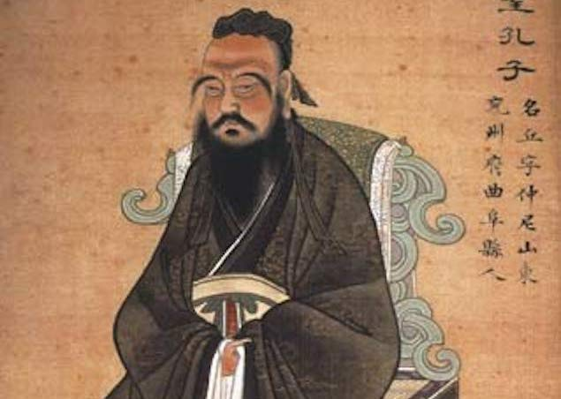
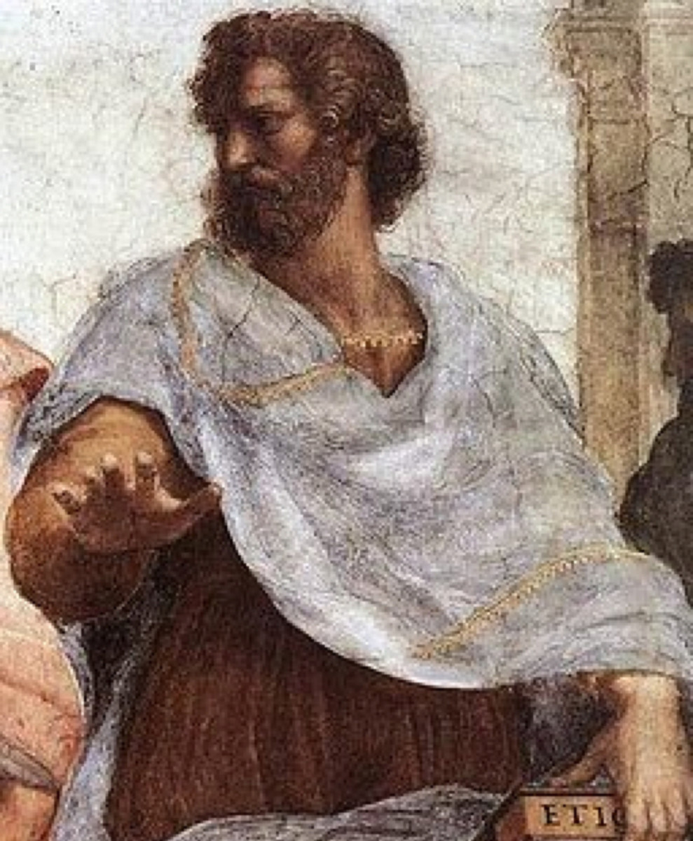
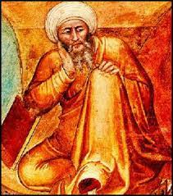
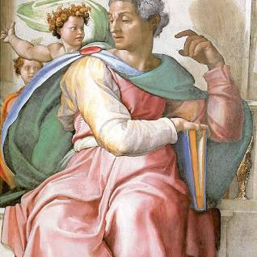
ANCIENT WISDOM FOR MODERN CHALLENGES

Slide 36
SIX SHARED PILLARS OF ANCIENT WISDOM
VIRTUE ETHICS: HAPPINESS IS BUILT BY CHARACTER
HUMAN STRUGGLE BETWEEN THEIR LOWER URGES AND
HIGHER CALLING
REASON (UNDERSTANDING) IS THE PATH TO THE HIGHER CALLING
HUMAN VISION OF PERFECTION AND STRIVING TOWARDS IT
SCIENCE AND SPIRITUAL ARE CONJOINED
THERE IS A SINGLE HUMAN FAMILY

Slide 37
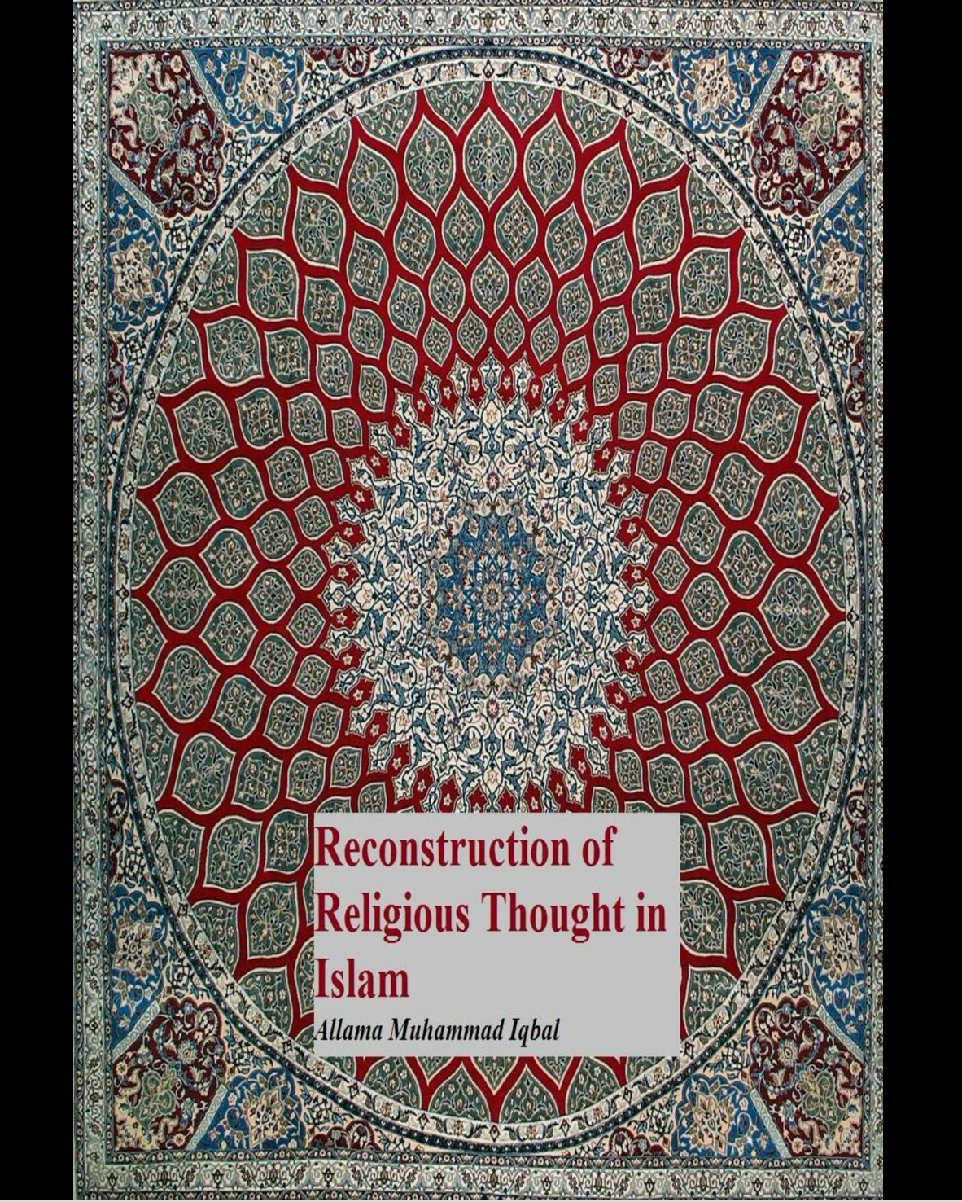
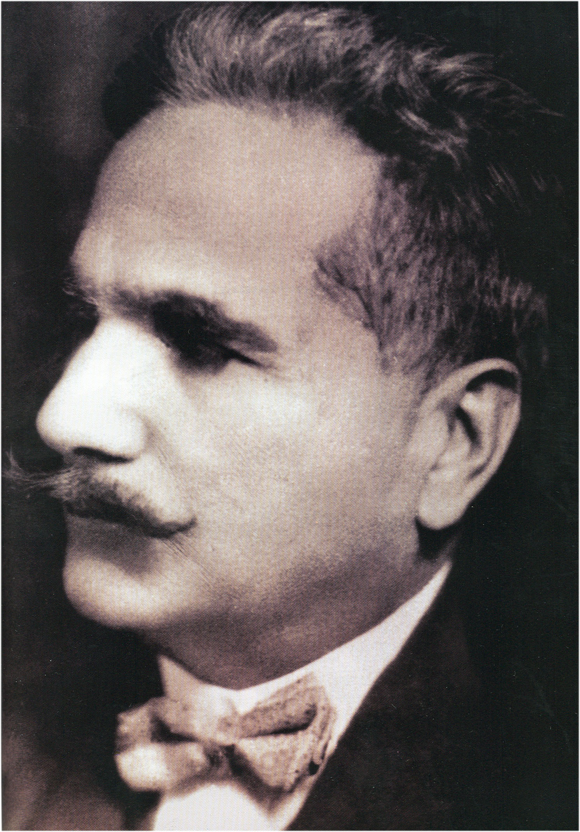
Islam as “a Message for Humanity”

Slide 38
The search for rational foundations in Islam may be regarded to have begun with the Prophet himself. His constant prayer was: ‘God! grant me knowledge of the ultimate nature of things!’ (p. 2)
The main purpose of the Qur’«n is to awaken in man the higher consciousness of his manifold relations with God and the universe. (p. 5)
Iqbal, Allama Muhammad. Reconstruction of Religious Thought in Islam. Kindle Edition.

Slide 39
Foundational Support for 21st Century Global Ethics

Slide 40
UNIVERSAL DECLARATION OF HUMAN RIGHTS (1948)
Article I
All human beings are born free and equal in dignity and rights. They are endowed with reason and conscience and should act towards one another in a spirit of brotherhood.
Article 2
Everyone is entitled to all the rights and freedoms set forth in this Declaration, without distinction of any kind, such as race, colour, sex, language, religion, political or other opinion, national or social origin, property, birth or other status.
Furthermore, no distinction shall be made on the basis of the political, jurisdictional or international status of the country or territory to which a person belongs, whether it be independent, trust, non-self-governing or under any other limitation of sovereignty.

Slide 41
 | Main Drivers | Deep Remedies | Institutional Approaches
Wars of Plunder | Inequality of Power | Convergence of Power | Collective Security, Global Economic Structures of Convergence
Great Power Wars | Competition for Power | Multipolarity rather than Hegemony or Alliance Politics | Inter-Regional Dialogue and Negotiation; Intra-Regional Cooperation; Reform of UN Security Council
Inter-Ethnic Wars | Communal Fear | Multi-ethnic polities that ensure group as well as individual rights | Unity in Diversity; ancient wisdom and culture for modern challenges; dialogue

Slide 42
The UN remains indispensable for our survival even as its
fragility in the face of great power politics,
private greed, and state impunity are repeatedly revealed.

Slide 43
JFK, AMERICAN UNIVERSITY PEACE SPEECH, JUNE 10, 1963

Slide 44
“So, let us not be blind to our differences--but let us also direct attention to our common interests and to the means by which those differences can be resolved. And if we cannot end now our differences, at least we can help make the world safe for diversity. For, in the final analysis, our most basic common link is that we all inhabit this small planet. We all breathe the same air. We all cherish our children's future. And we are all mortal.”
― John F. Kennedy

