Slide 1
INDONESIA
An Emerging Economic Powerhouse in Asia

Slide 2
OUTLINE
The Map
Indonesia in Brief
Current Indonesia Economy Profile
Indonesia and Slovakia Economic Relationship
Why Indonesia
Indonesia Trade Expo 2014
Conclusions

Slide 3
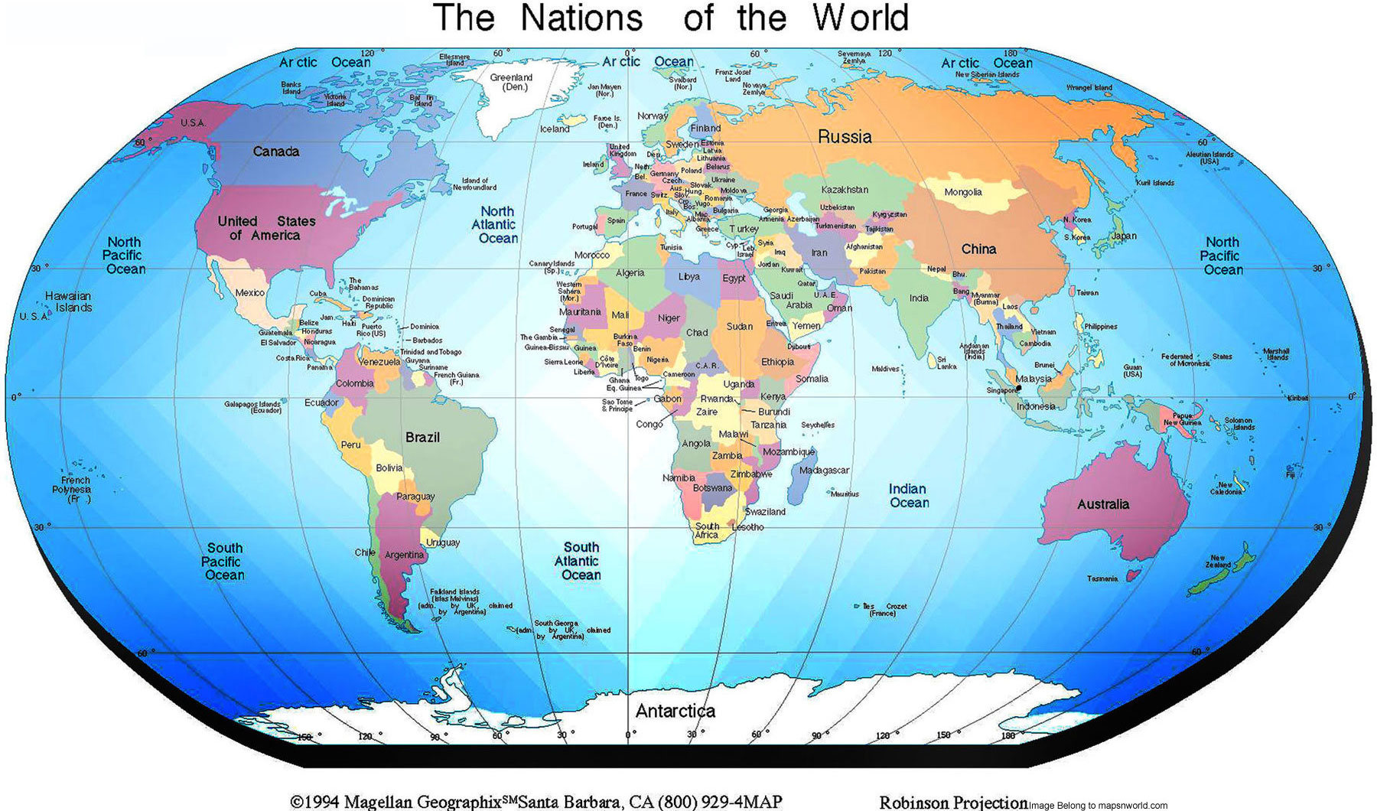

Slide 4
I
Strategic location:
crossroads two oceans (the Pacific and Indian Oceans),
bridges two continents (Asia and Australia)
Stretching from east to west in the equator for 5.150km (±3200 miles)
Largest Archipelago: 17.508 islands (5 main islands, 6.000 islands inhabited)
Sea area is four times greater than land area
A vast, huge, diverse and polyglot nation 500 ethnic groups with more than 700 languages and dialects. Bahasa Indonesia is the official language
Abundance of Natural Resources & Fertile Soil

Slide 5
INDONESIA ECONOMIC PROFILE
2010 - 2014
Economic Growth | Avarage 6,3 – 6,8 % annually
Inflations | Avarage 4 - 6 % annually
Unemployment Rate | 5 – 6 % in the end of 2014
Poverty Rate | 8 – 10 % in the end of 2014
2010
GDP: USD 700 Billion
Income/capita: USD 3,005
2011
GDP: USD 800 Billion
Income/capita: USD 3,543
2014
GDP: USD 1,2 Trillion
Income/capita: USD 4,800 – 5,000

Slide 6
The Indonesian Economic Growth and the World
The Economic Growth | 2010 | 2011 | 2012 | 2013
The Economic Growth of the World | 5.1 | 3.9 | 3.2 | 3.5
Central and Eastern Europe | 4.6 | 5.3 | 1.8 | 2.4
ASEAN 5 (Indonesia, Malaysia, Philippines, Thailand and Vietnam) | 7.0 | 4.5 | 5.7 | 5.5
The Economic Growth of the Indonesia | 6.2 | 6.5 | 6.3 | 6.8

Slide 8
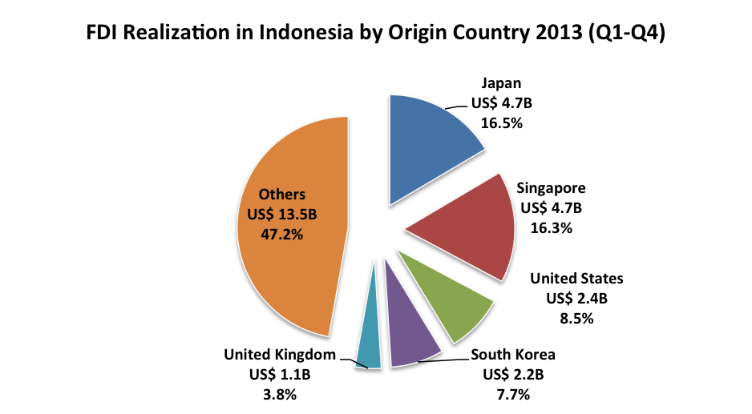

Slide 9
Source: Ministry of Trade of the Republic of Indonesia

Slide 10
Direct trade between Indonesia and Slovakia and trade trough third countries (Singapore and Germany)
Source : Ministry of Economy of the Slovak Republic

Slide 11
Country | Export to Slovakia
Vietnam | 1184.327
Malaysia | 231.780
Thailand | 177.910
Indonesia | 97.515
Singapore | 41.202
Philippines | 14.892
Cambodia | 17.834
Myanmar | 1.067
Source: The Statistical Office of the Slovak Republic (SO SR)

Slide 12
Country | Import from Slovakia
Vietnam | 9.766
Malaysia | 13.296
Thailand | 18.204
Indonesia | 7.762
Singapore | 31.173
Philippines | 3.885
Cambodia | 0.155
Myanmar | 0.113
Source: The Statistical Office of the Slovak Republic (SO SR)

Slide 13
Main export Indonesia to Slovakia:
Food products
Footwear
Electrical machineries
Plastic products
Garment and sportswear
Accessories
Furniture
Handicrafts
Musical instruments
Tea
Coffee
Sugar
Fruits
Peanuts
Products of wood
Leather
Metal
Tin
Textiles
Toys
Main Import Indonesia from Slovakia
High tech products
Machinery products (farm machinery)
Weapon products
Chemical products
Nuclear reactor
Vehicles
Musical instruments
Measuring equipments
Tools
Metals
Glass

Slide 14
Indonesia and Slovakia signed 15 agreements:
Government-to-Government
Investment Coordinating Board (BKPM) and Slovak Investment and Trade Development Agency (SARIO) on capacity building
Public Radio RRI and Slovak Radio and Television
University of Andalas and OSIVO of Agriculture University (SPU) NITRA on exchange of personnel in wheat projects
Nuclear Energy Regulatory Agency (Bapeten) and Slovak Nuclear Regulatory Authority UJD on the exchange of technical information and cooperation in nuclear safety
The other 11 agreements, worth up to $1 billion, are between:
Bank BNI and Slovak Eximbanka
PT Indonesian Eximbank and Slovak Eximbanka
PT Pindad with Slovak Security and Defense Industry ZBOP on system development
PT Laya’tiyanna Ichsan and Istroenergo Group on a power plant project
Henry company and Instroenergo Group on a power plant project
PT Sugico and Hornonitrianske Bane Prievidza on coal mining development
PT Surya Kirana Duta Mas and Konstrukta Industry on a tire factory project in Tangerang
PT Surya Kirana Duta Mas and Pio Keramoprojekt on a cement factory in Central Java
Galenium Pharmacy and Sicorp Slovakia on the drug industry
Tri Agri and Compel Industries on CPO exports to Central and East Europe
Lippo Group and Pio Keramoprojekt on a cement factory in West Papua

Slide 15
The 8th Business Round Table (BRT) Bali, December 2, 2013
Agreements:
Indowana Power and Istroenergo Group Levice on Industrial Power Plant 60 MW (ethanol production) in East Kalimantan
PT. Gistec Prima and PIO Keramoproject Trencin on Miripi Integrated Cement Plant and 40 MW Power Plant in Manokwari West Papua
PT Triutama Dasa Indonesia (joint venture company of Zeus Investment&Mining Ltd, Singapore and PT Star Vybros) and PIO Keramoproject Trencin on Cement Plant 1.73 million MT in Chiara Banten
Indowana Power and Istroenergo Group Levice on Power Plant 2x100MW Angana and 160 km of high voltage line 150 kv in East Kalimantan
Indowana Power and Istroenergo Group Levice on Power Plant 2 x25 MW in Karimun

Slide 16
FUTURE TRADE & FDI
Indonesia had the largest potential for geothermal energy production, yet only 5 percent of the 40 percent of the world’s geothermal potential located in Indonesia, had been utilized.
Indonesia also has great potential to develop water-powered electricity generators due to the country’s archipelagic nature.
Slovakia’s expertise in energy and infrastructure have great potential in helping Indonesia harness its natural resources
Indonesia could also be a potential consumer for Slovakia’s products, such as military vehicles, arms and food products

Slide 17
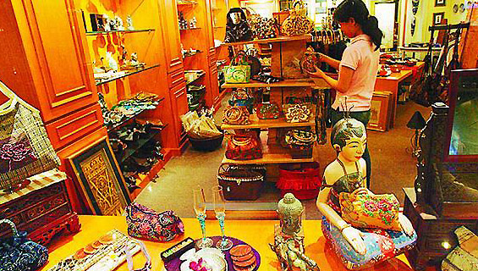
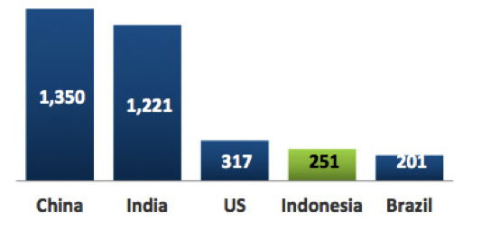
WHY INDONESIA
Large population
Indonesia is literally a giant
Its market alone exceeds some 251 in 2013 million people (4th largest country in the world in terms of its population after China, India, and the United States)
A vibrant labor force of skilled and educated workers
World’s Top-5 Population
by Country (million people)
Large numbers of Small and Medium Enterprises
The business people in Indonesia (42 million), mostly are dominated by local private business entrepreneurs, have built their small&medium enterprises while managing to make millions of profit.
This fact shows that the economy in Indonesia is not solely run by giant business companies, but also by simple local businessmen who have started with few pennies and turned them into businesses worth thousands of dollars.
Source: Central Intelligence Agency US, 2013 (Estimation)

Slide 18
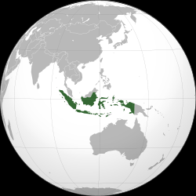
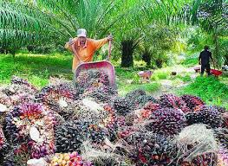
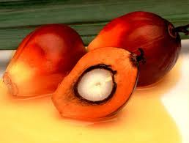
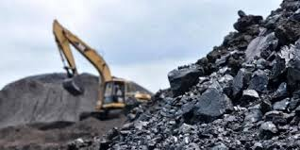
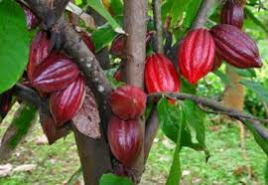
WHY INDONESIA
A vast and fertile land rich in natural resources
Ranked as the 16th largest country in the world
Indonesia, with its tropical climate and humidity, is rich in natural resources
Indonesia is one of the world’s major producer of a broad range of commodities
Indonesia’s crude palm oil is ranked as the first in the world, while its tin and cocoa occupy the 2nd position
Other natural resources such as nickel, gold and copper are ranked 5th, 7th and 8th,respectively, as well as numerous marine resources.
Strategic location: vital international transport routes
Indonesia is located between 2 continents (Asia &Australia)& 2 oceans (Pacific&Indian) which puts it in a strategic location for international transport routes.
One of the most important transport routes vital for international transport & used by international shipping for business purposes is the Malacca strait (lies between Malaysia & Indonesia (Sumatera island)).
Many ships navigate through the Malacca strait en route to Australia and other Asia countries.

Slide 19
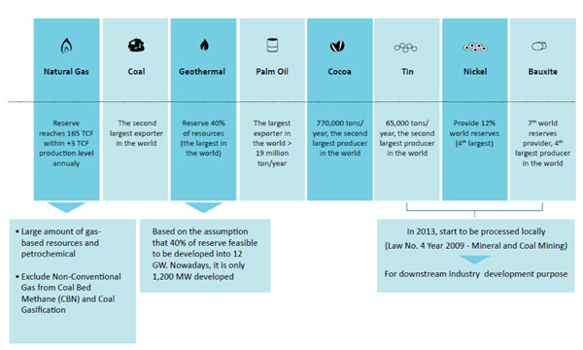
Abundant Natural Resources: The Key Indicators
Source: Coordinating Ministry For Economic Affairs RI, 2011

Slide 20
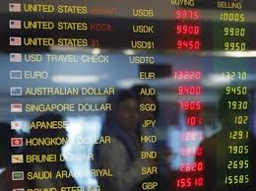
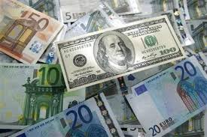
WHY INDONESIA
Open and liberal market economy
The ASEAN Free Trade Area (AFTA) has now been virtually established. ASEAN Member Countries have made significant progress in the lowering of intra-regional tariffs through the Common Effective Preferential Tariff (CEPT) Scheme for AFTA.
The Free Trade Area will usher in the market economy in Indonesia with its open and liberal policies. Every sector in Indonesia is open for investment. With the simplification of rules and regulations, Indonesia’s market economy will be openly accessible for foreign investors.
Free foreign currency exchange system
In the case of business profits in particular, a foreign investor will be able to transfer the profit of his business in Indonesia straight to his homeland and convert into the currency of his homeland without any involvement by the central government.
This is one of the advantages for foreign investors as there will be no complicated procedures in receiving their profits in the currency of their country.

Slide 21
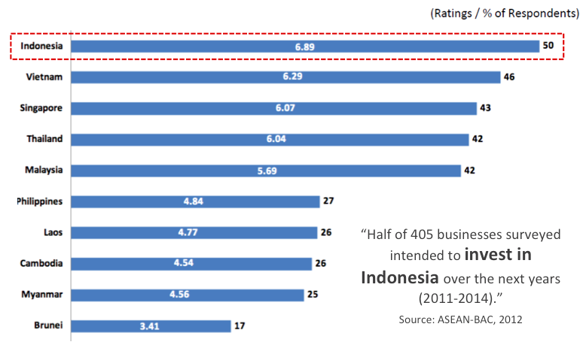
The Most Attractive Investment Destination in ASEAN

Slide 22
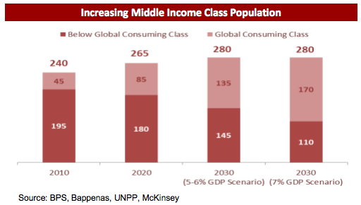
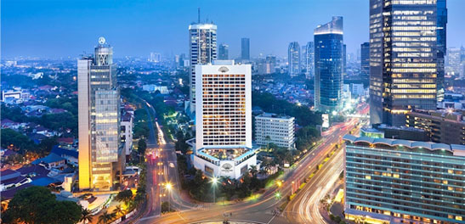
WHY INDONESIA
Emerging middle class is driving Indonesia's boom
According to a recent Bloomberg article, Indonesia’s 240 million people are currently “basking in a consumer and resources driven boom.”
There are tens of millions of households on the brink of making the leap into the bankable class, the report enthuses.
These emerging middle income earners – said to number 35 million – are proving eager and discerning consumers, who will seek out and pay for quality.
They are a key driver of the Indonesian economy, tipped To increase by more than 6 percent this year.

Slide 23
INDONESIA
10
POTENTIAL
COMMODITIES
Leather & Leather Products
Medical Instrument and Appliances
Medicinal Herbs
Processed Food
Essential Oil
Fish & Fish Products
Handicraft
Jewelry
Spices
Stationery Non Paper

Slide 24
NINE CORE AREAS FOR INVESTMENT
First: Infrastructure Building
Second: Transportation
Third: IT and Telecommunications
Fourth: Food Industry and its R&D
Fifth: Energy Industry, including renewable industry
Sixth: Mining Industry
Seventh: Manufacturing Industry
Eighth: Creative Industry
Ninth: Training and Education, Research, Development and Innovation.

Slide 25
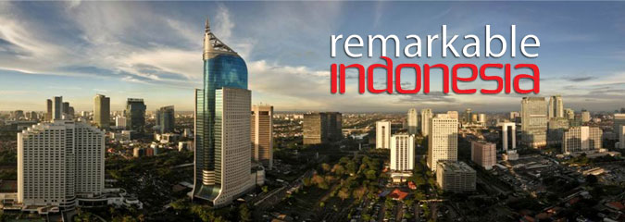
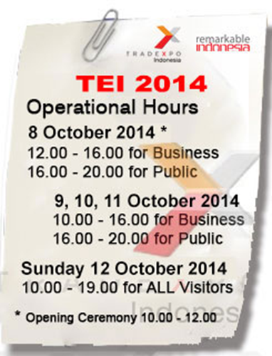
29th Trade Expo Indonesia 2014 (Jakarta, 08 - 12 October 2014)
Tradexpo Indonesia 2013:
attracted more than 9.000 buyers from over 100 countries,
total trade transactions valued at over US$ 1,5 billion.
The fact that thousands of buyers from many countries come to visit Resources (Tradexpo) Indonesia every years demonstrates a high commitment of our trading partners around the world; and also a solid prove that Indonesia is one of the potential and reliable suppliers of qualified and competitive consumer products.

Slide 26
Main Products | Automotive components Cocoa Coffee CPO Electricity & Electronics Footwear | Furniture Rubber & Rubber Products Textile & Textile Products
Potential Products | Essential Oils Processed Foods Handicrafts Medical Herbs Jewerly & Accessories | Leather & Leather Products Medical Instruments & Appliances Spices
Services
Multy Products | Agriculture Products Building Materials Chemical Products Foods & Beverages Glassware | Sport Equipments Households Goods Miscellaneous Paper Products

Slide 27
BUSINESS TRIP
TO INDONESIA
The Indonesian Embassy will arrange the Business Trip to Indonesia
on 6 - 10 October 2014
6th : Depart from Bratislava
7th : Arrive in Jakarta & check in hotel
8th : Opening of the 29th TEI 2014
9th : Business Meeting with Indonesian Partners
10th : Check out from the hotel

Slide 28
D’akujem
THANK YOU
Embassy of the Republic of Indonesia

