Slide 1
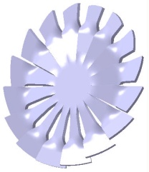
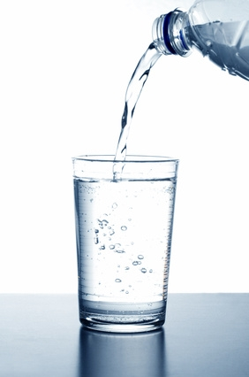
Vitalturbine™
V italization
i onization
t urbulence
a ctivation of
l iquids

Slide 2
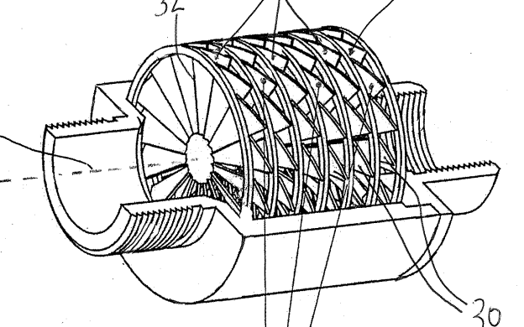
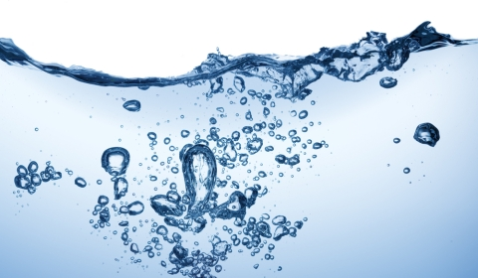
Vitalturbine™Water Vitalizing System
Theoretical Background
Two effects can be observed, that occur simultanously:
1.) A Physical Effect: caused by the material properties of the metal disks
2.) A Bioenergetic Effect: caused by the specific shape of the metal disks

Slide 3
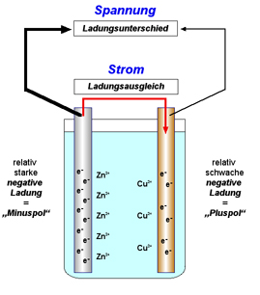
Vitalturbine™Water Vitalizing System
Theoretical Background Galvanic Element
Galvanic Element: Two metal disks with different electronegativity, separated by dielectric spacers and generating a voltage of approximately 0,7 – 1 V
Water working as an electrolyte
When water passes between the metal disks it changes its ion composition therefore resulting in measurable changes of physical properties:
  Increase of pH (alkalinization)
  Increase of conductivity
  Increase of redox potential

Slide 4
Vitalturbine™Water Vitalizing System
Theoretical Background Galvanic Element
The effect only occurs in liquids with natural mineral content -> no effect observed in distilled water or water treated by reverse osmosis
The technology can therefore be applied to bottled spring water or tap water of good quality
The technology is also able to reduce limescale by changing Calcium- and Magnesium carbonates to their hydroxides

Slide 5
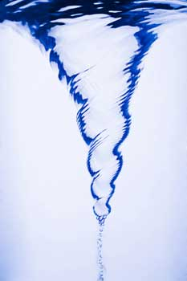
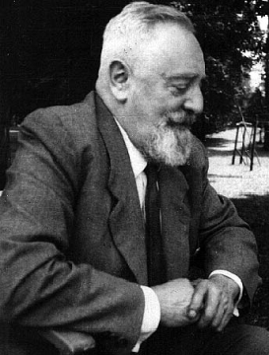
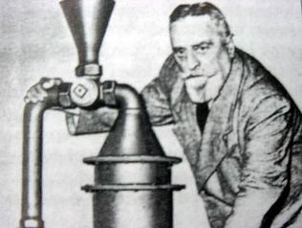
Vitalturbine™Water Vitalizing System
Theoretical Background Bioenergetic Effect
Theory developed by Viktor Schauberger
(1885 – 1958), Austrian naturalist, philosopher, inventor, expert on Biomimicry. His motto was: „understand and copy nature“

Slide 6
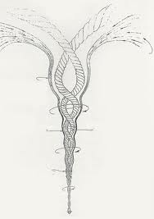
Vitalturbine™Water Vitalizing System
Theoretical Background Bioenergetic Effect
Water spiralization causes a „positive“ and „life sustaining“ force called Levitation
Specific water movement and
certain turbulences which occur
naturally in flowing water show
the best „energizing“ effect

Slide 7
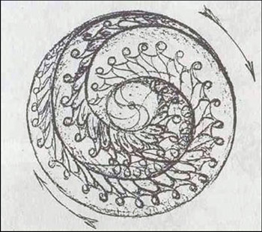
Vitalturbine™Water Vitalizing System
Theoretical Background Bioenergetic Effect
The shape of the metal disks initializes specific turbulences and vortices
- The effect results in a change of the water‘s bioenergetic properties, which is measurable with certain specialized equipment (Prof. Kurik, University of Kiev)

Slide 8
Vitalturbine™Water Vitalizing System
Possible applications of the technology
Small scale water treatment of drinking water like bottled mineral water: additional health benefit by drinking activated, ionized water
Large scale water treatment in domestic water supply systems, industrial water supply and water used for irrigation: limescale removal, improvement of tap water quality

Slide 9
Vitalturbine™Water Vitalizing System
Testimonial by Prof. Kurik
Ukrainian institute of Human Ecology
This conceptually new galvanic water activator changes basic physico-chemical properties of water. It is leading to improvement of energetic properties of water and its activation - what in total represents a beneficial effect on the human body that uses this modified water.

Slide 10
Vitalturbine™Water Vitalizing System
Product Development
Screwable bottle cap
Fitting on conventional mineral water bottles (European Standard Thread)
Generates defined voltage for ionization and vitalization of drinking water
Made from certified food-proof materials according EU guideline 1935

Slide 11
Vitalturbine™Water Vitalizing System
Product Development USP
Positioning as a „Wellness“ product for the consumer market
People already interested in health issues and aware of the importance of good quality drinking water can gain additional benefit „by detoxification and by reducing hyperacidity therefore having more energy for each body cell.“
Semi-disposable product (limited usage time)

Slide 12
Vitalturbine™Water Vitalizing System
Patent and Trademark Situation
2 European Patent applications filed: for a water vitalizing bottle cap and a bottle with an integrated Vitalturbine
3 US Patent applications filed (Patent pending): the water vitalizing bottle cap, the bottle with an integrated Vitalturbine and the Vitalturbine technology itself

Slide 13
Vitalturbine™Water Vitalizing System
Patent and Trademark Situation
2 US Trademark applications filed: VITALTURBINE™ (technology) and KALYXX™ (bottle cap)
3 EU Trademark applications filed

Slide 14
Vitalturbine™Water Vitalizing System
3 Options for Collaboration with Mineral Water Suppliers
Distribution of existing product KALYXX™
Production of an OEM product
VITALTURBINE™ cartridge to be included into existing corporate design and marketing strategies

Slide 15

Vitalturbine™Water Vitalizing System
Option 1
Premium price, design oriented tableware item and „Wellness“ product ->
product certified and tested in EU, series production ready

Slide 16

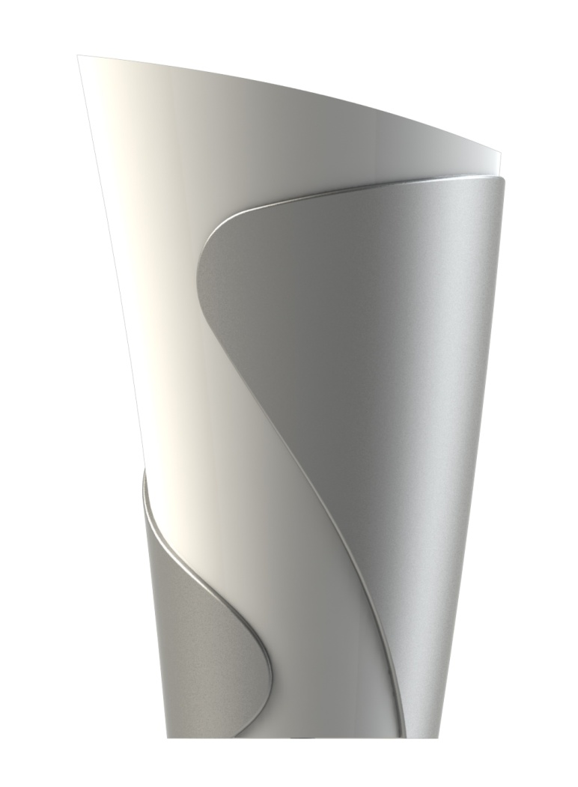
Water Vitalizing System

Slide 17
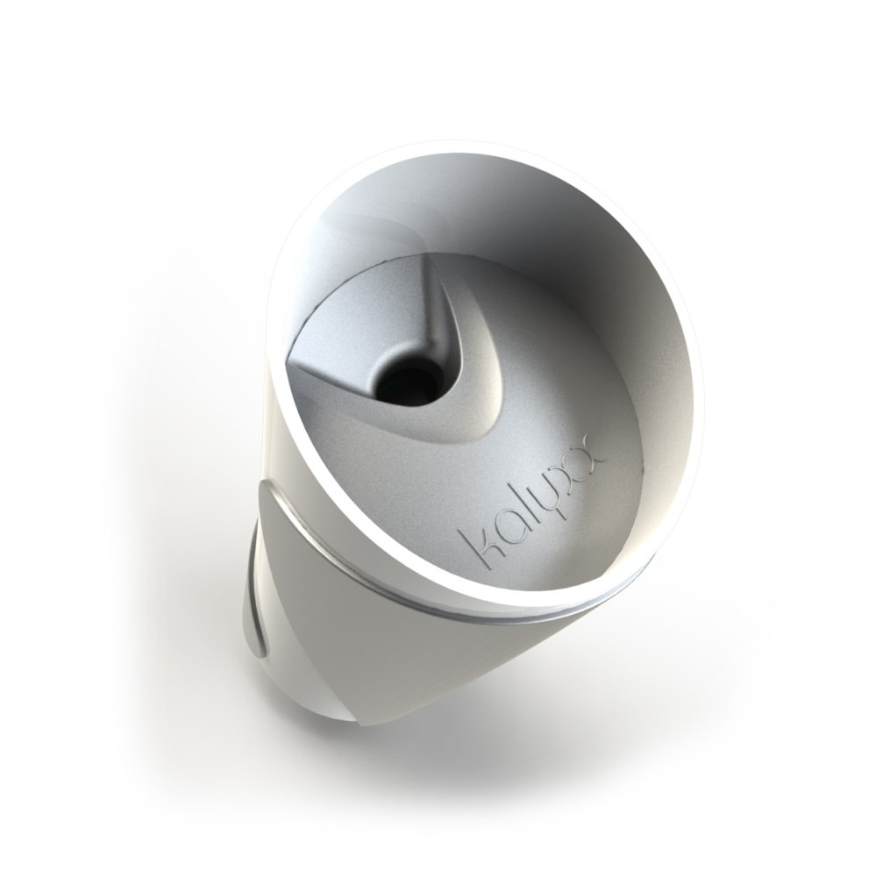
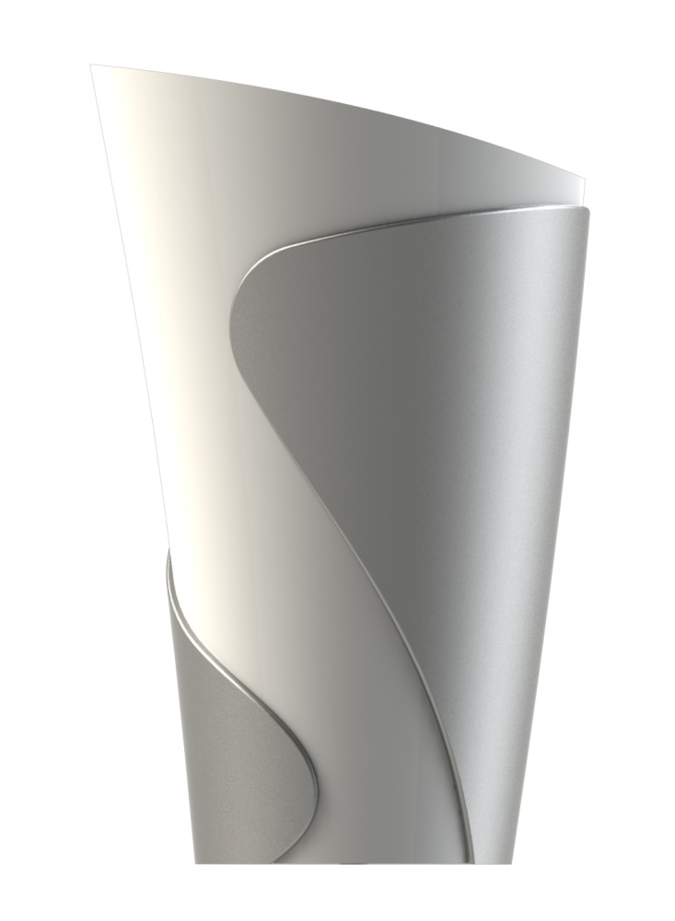
Product Design

Slide 18
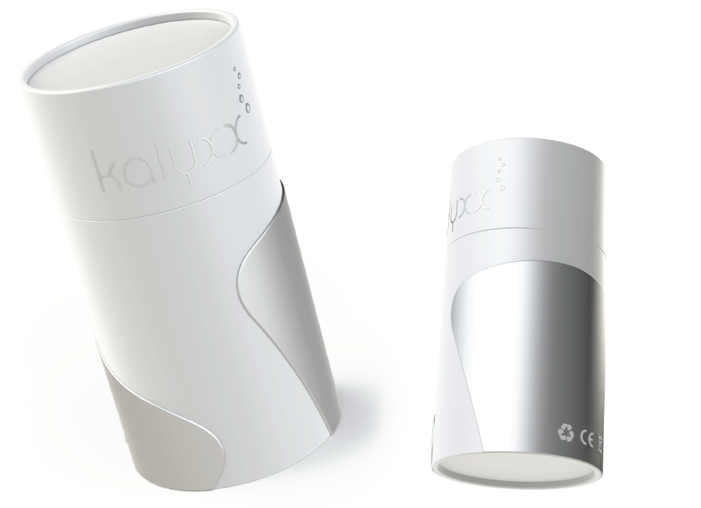
Product Package Design

Slide 19
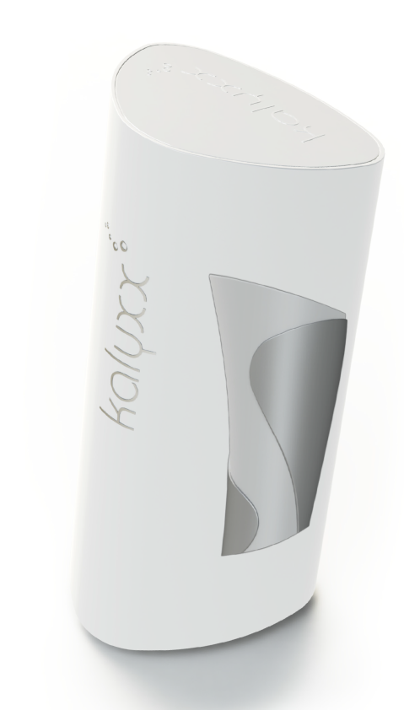
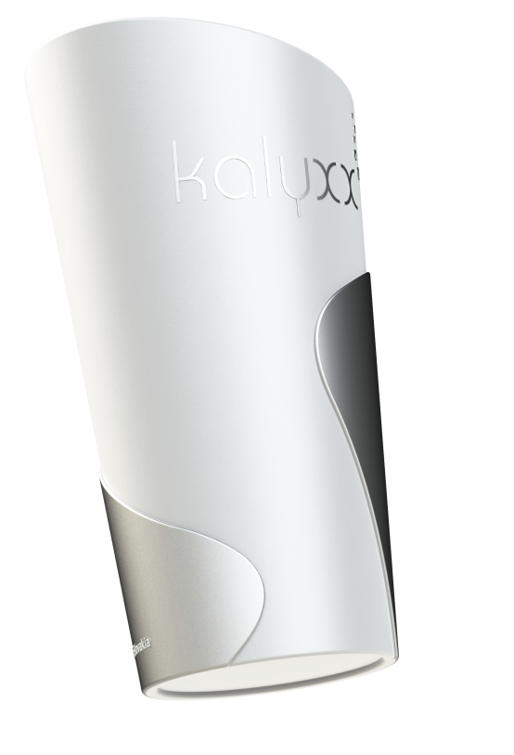

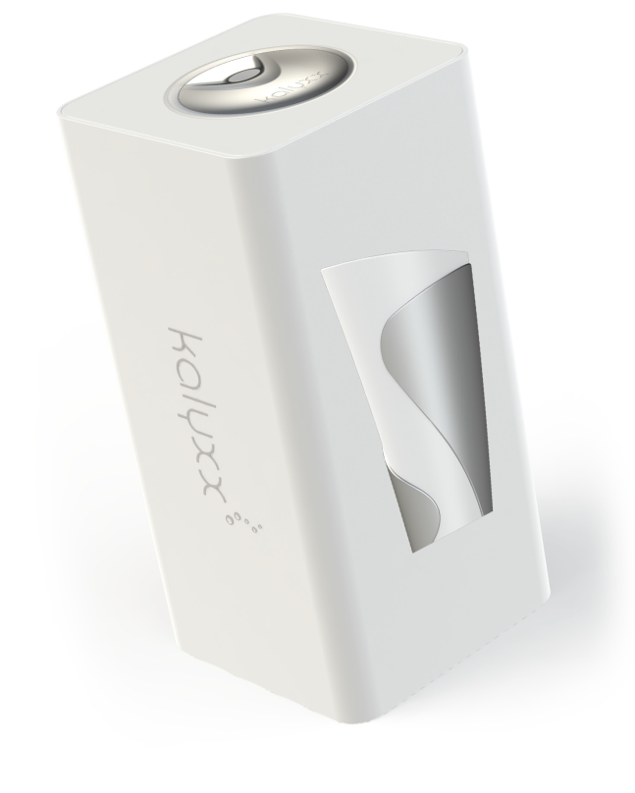
Product Package Design II

Slide 20
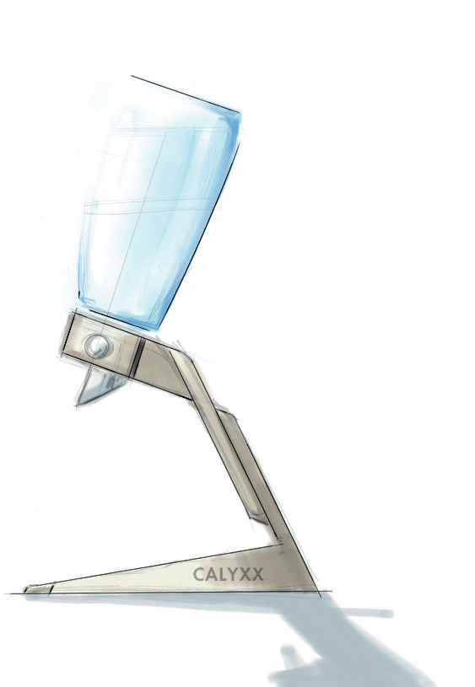
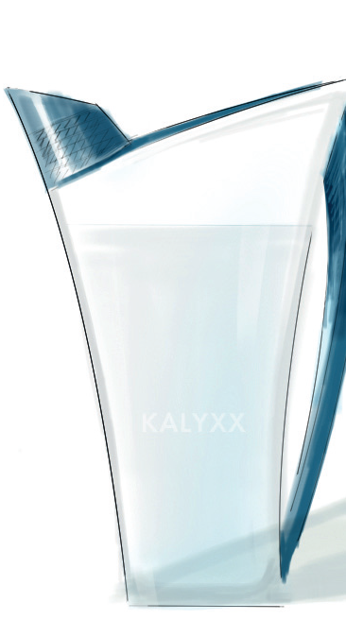
Product Design

Slide 21
Vitalturbine™Water Vitalizing System
Option 2
OEM product with customized product design, logo, packaging, brand name and price range
Size and format of the outer shell needs to be suited to encase the VITALTURBINE™ cartridge

Slide 22
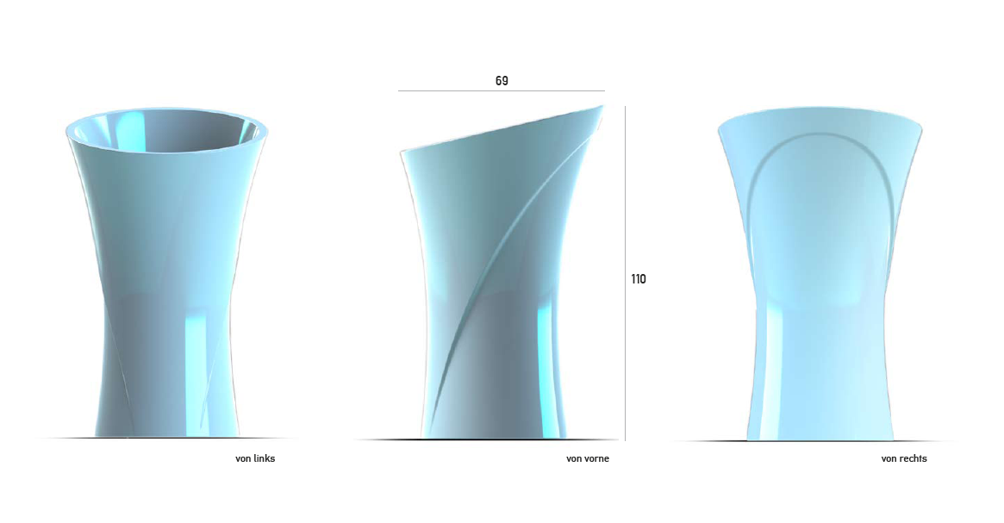
Vitalturbine™Water Vitalizing System
Option 2 (possible product design)

Slide 23
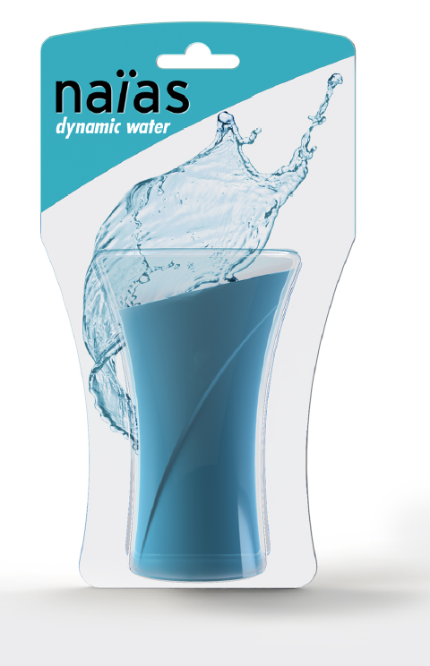
Vitalturbine™Water Vitalizing System
Option 2 (possible product packaging)

Slide 24
Vitalturbine™Water Vitalizing System
Option 3
VITALTURBINE™ cartridge to be included into existing corporate design and marketing strategies

