Slide 1
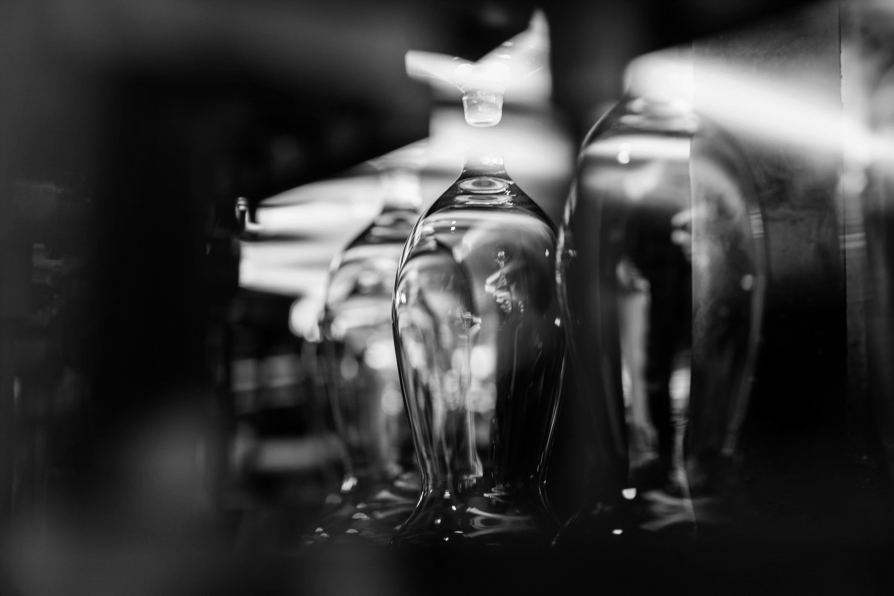
Glassmaking since 1892

Slide 2
General information
Company with a strong export position, qualified staff and cutting edge technology
One of the world's leading and largest manufacturers of nonlead household crystalware
Annual turnover of EUR 69,4 million (2019)
Company with long tradition and experience – it was founded in 1892 in Lednicke Rovne, Slovakia in the area where families worked at the glassworks for generations
Current number of employees is 1300

Slide 3
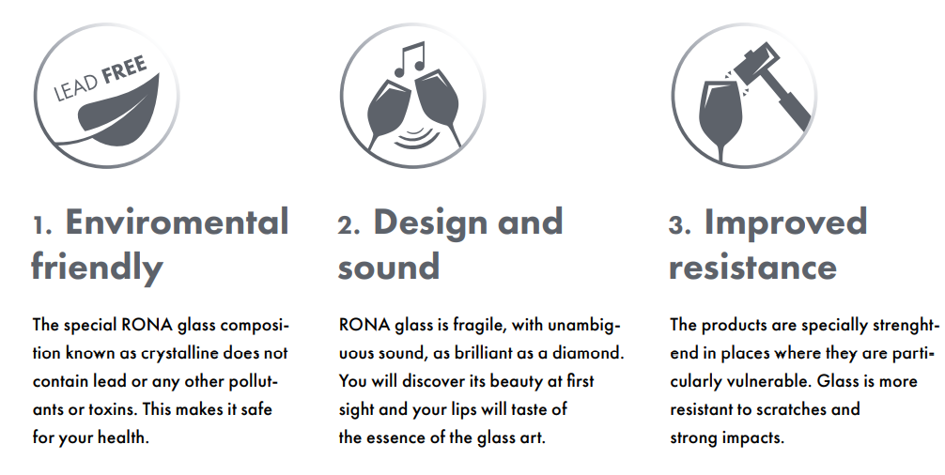
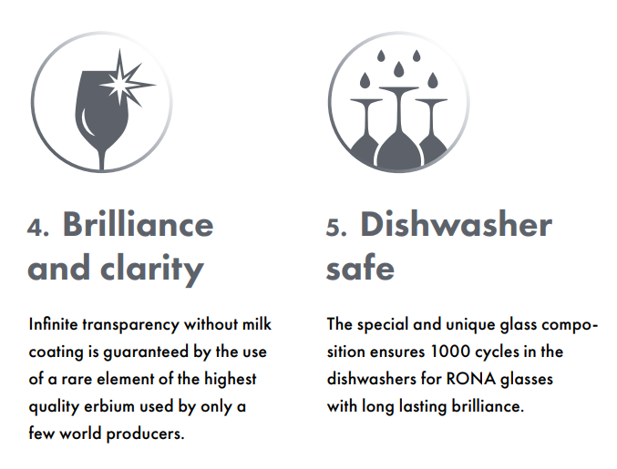
Five star glass
RONA products and quality rank it among the world´s leading manufacturers of the table top glassware with design created by a team of highly experienced, professional glass designers.

Slide 4
Machine made production
Qualified staff members, right motivation and managing the demanding technologies are the basic principles of RONA success story recently.
It does not concern only application of modern processes for glass making, but also regular improvements of all phases of the production processes with the aim to achieve the best execution of the finished products.
At the same time RONA´s production complies with the EU environmental legislation.

Slide 5
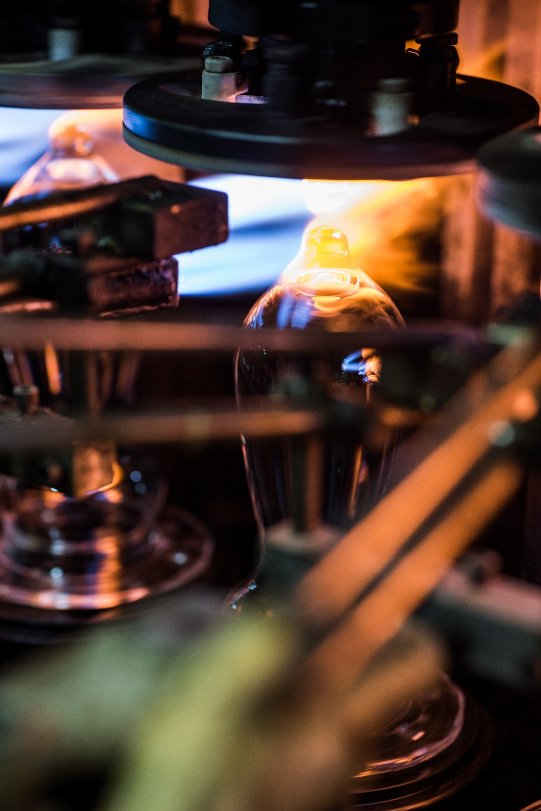
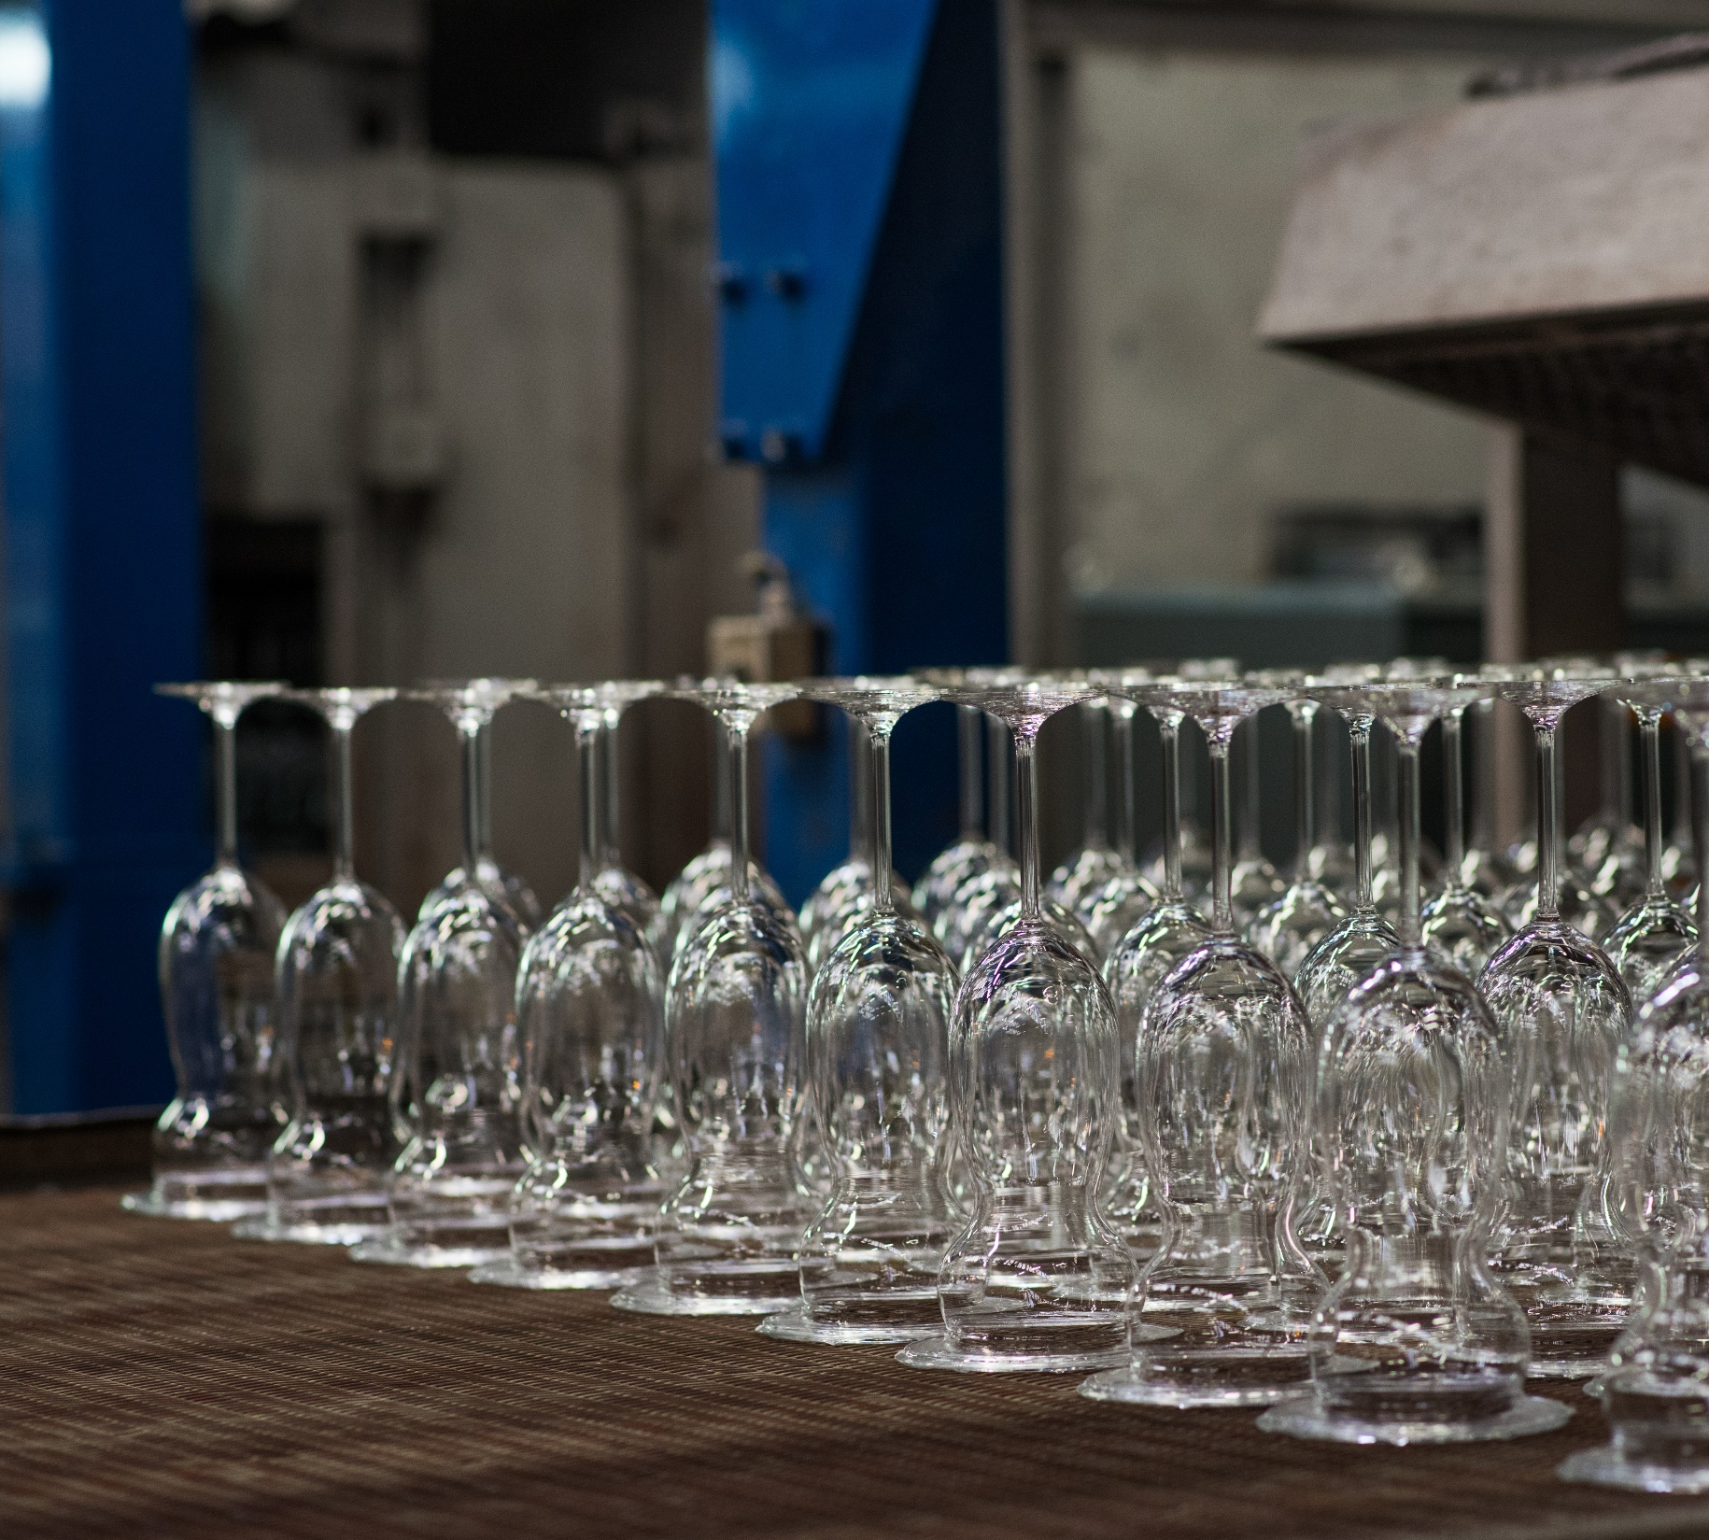

Slide 6
Hand made production
Finest product exquisitely mouth blown and handcrafted by RONA glassmasters, in Western Slovakia. Flawless clear glass made entirely by skilled master craftsmen. Each handmade item is an unique masterpiece that captures the mood and a memory to be treated with high respect.
Our handmade glassware is crafted by glassmasters with decades of experience and passion for their work – family tradition which is passed in this area through the generations for over 129 years.

Slide 7
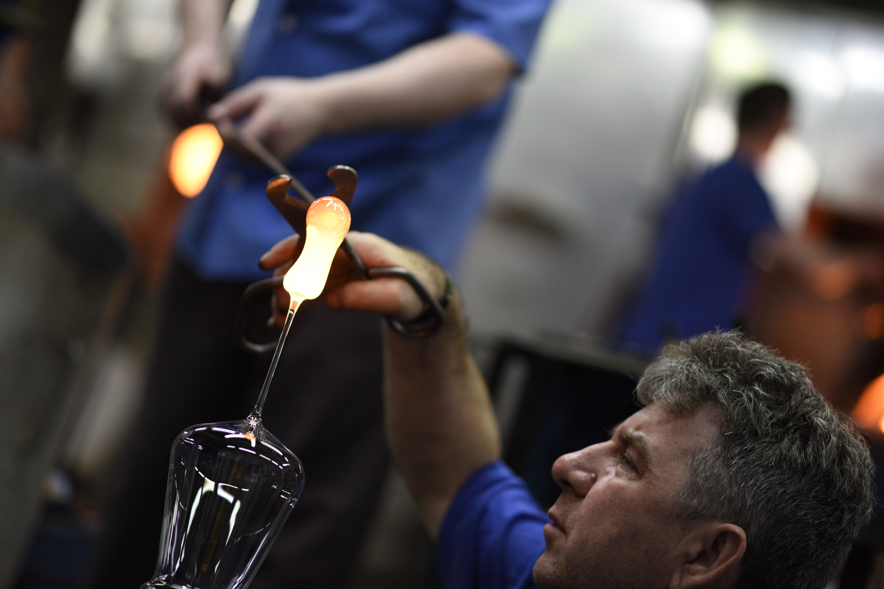
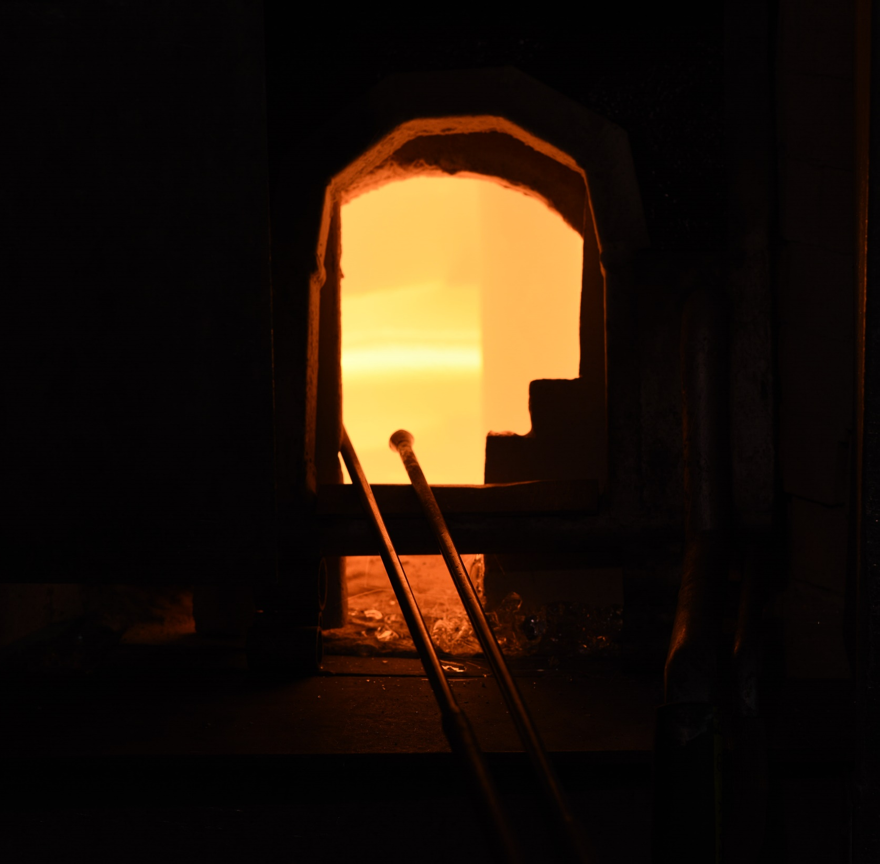

Slide 8
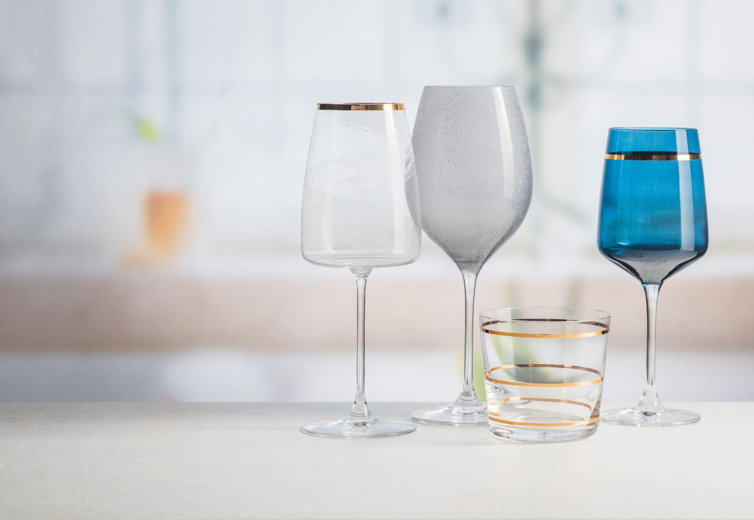
Decorative techniques
RONA Glassworks is capable of using an almost unlimited variety of decorating techniques, such as:
pantograph etching
diamond cutting
machine and hand cutting
hand painting
spraying of organic colors
sand blasting
screen printing and applying decals

Slide 9
Pulled stem
Progressive production technology – pulled stem.
Upgraded resistance during dishwashing and manual drying
Seamless stem makes the contact with glass pleasing
Joint-less transition from cup to stem provides extreme resistance to breakage
The glass is resilient, although remains flexible
Extremely hard surface proven according to the Vickers’ method

Slide 11
Product protfolio
RONA has over 2000 products in current offer, which are available for customers from more than 90 countries.
The portfolio of branded products is divided into 3 main segments:
RONA Household (Select)
RONA 2serve (HoReCa)
RONA Premium (handmade)

Slide 12
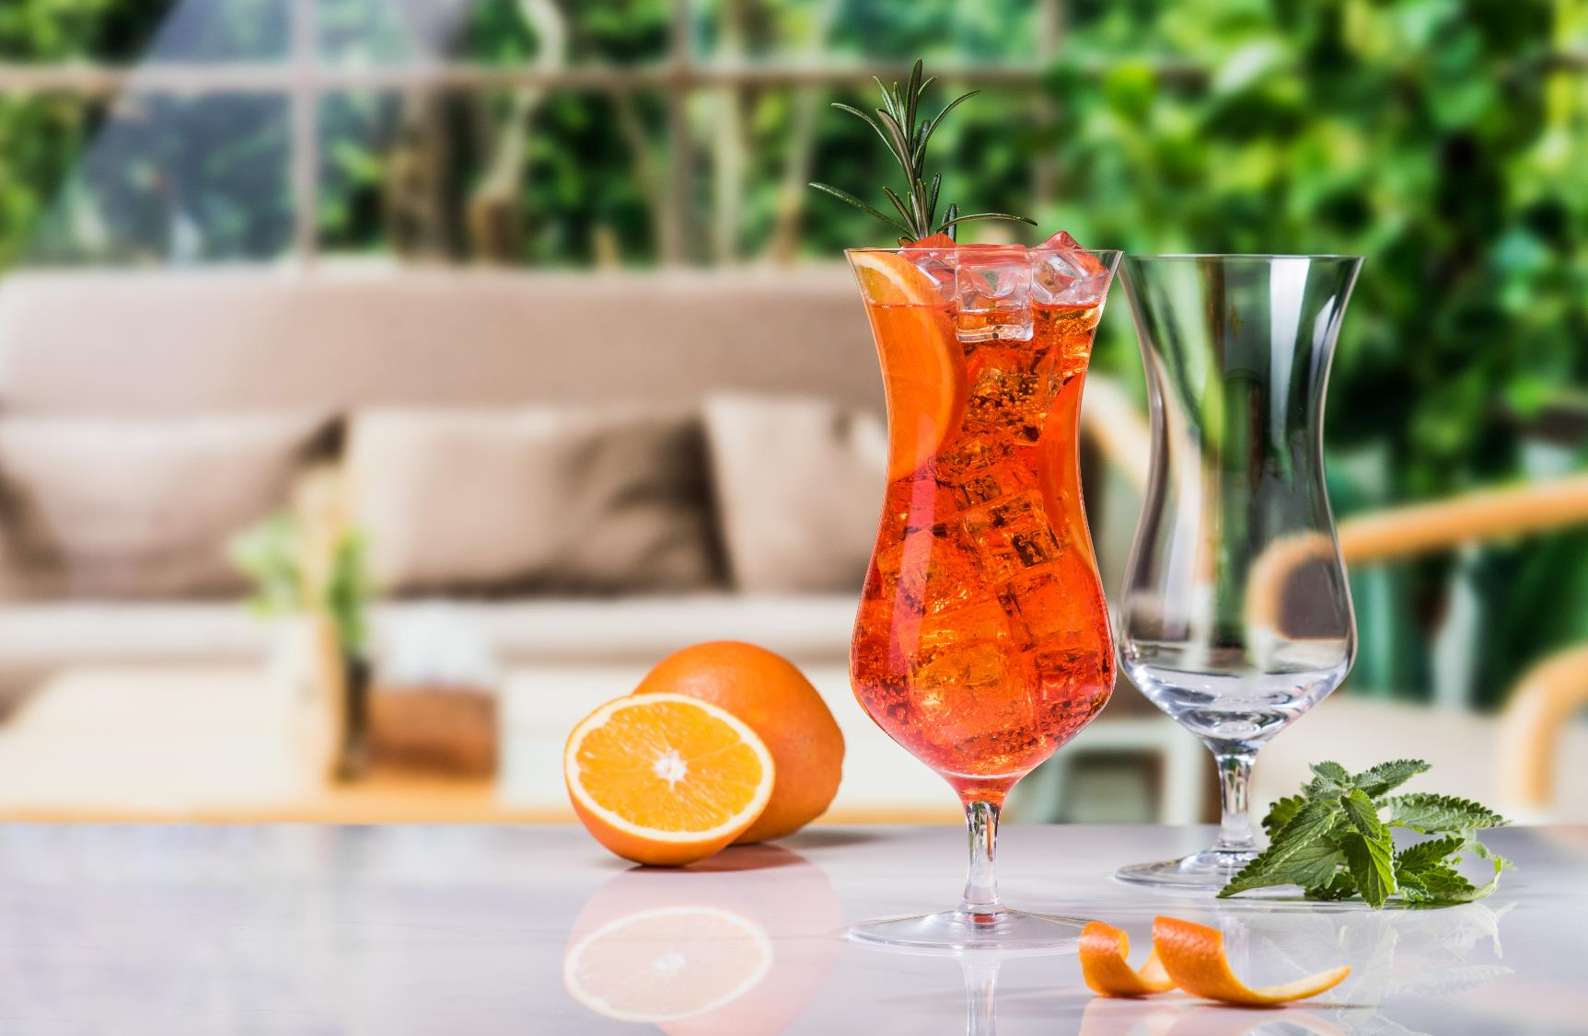
Household
Perfect glass for your complete home table setting. From the numerous shapes and sizes in RONA's glass portfolia, we have come up with the best selections to meet the taste of all wine loving consumers world-wide.
RONA´s concept glass selections will satisfy all your entertaining needs.

Slide 13
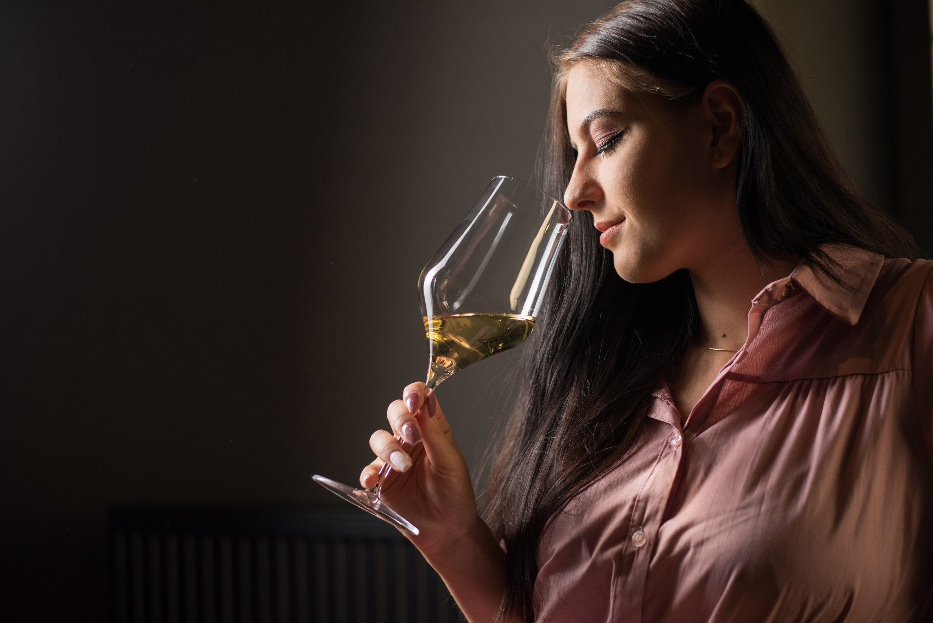
BALLET
Inspired by (or imagine) the ideal body type of ballerina: subtle, slim, elegant, gracefull and clean silhouette with long neck, firm long legs, solid smooth base with emphasis on technical precision, fluidity, strength and persistence in the performance. It is series BALLET with other highlights:
machine made by pulled stem technology
“V“ profile at the bottom of goblet bowl
new RONA E-commerce packaging
dishwasher safe lead-free crystalline glassware

Slide 14
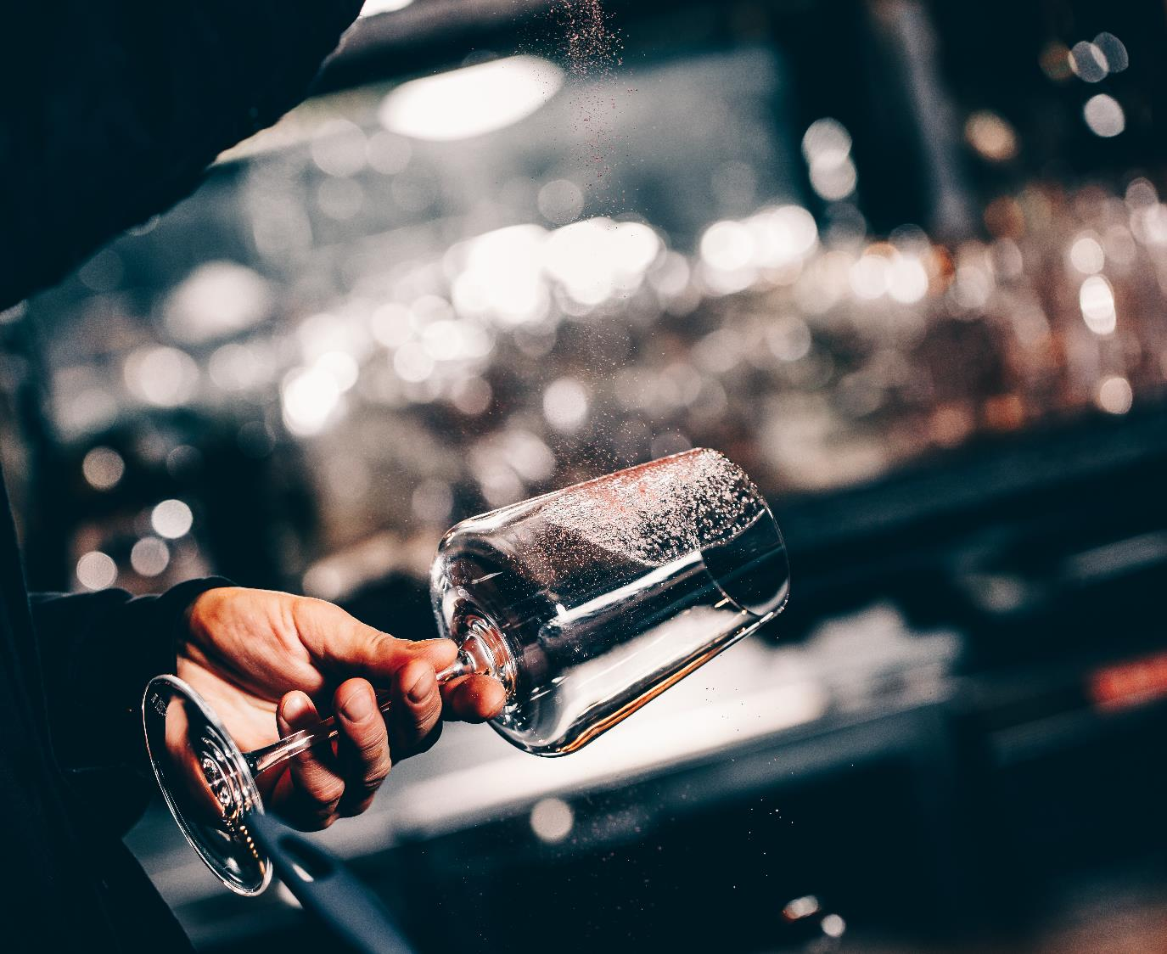
2serve
Under the RONA 5 Star brand you will find brilliant glassware produced for the hospitality industry. The most developed technology combination of the pulled stem and laser treatment provides the highest quality crystalline glassware, developed and made specifically for the professional service.
From the design to the final execution RONA producers only fully professional glassware which is extremely resistant and resilient for the hospitality industry under the "RONA 5 Star Glass„ brand.

Slide 15
LINEA UMANA
For the first time a line of glasses designed by somebody who uses them first-hand and expects a perfect performance. Maurizio Filippi - Best Italian Sommelier AIS 2016 - used all his expertise as a sommelier and restaurateur to create the soft and “human” lines of these wine glasses, without neglecting to take into account practical aspects that are important for potential buyers. Only seven wine glasses and two water glasses to meet the needs of all professionals in the sector and of all wines produced in the world.

Slide 16
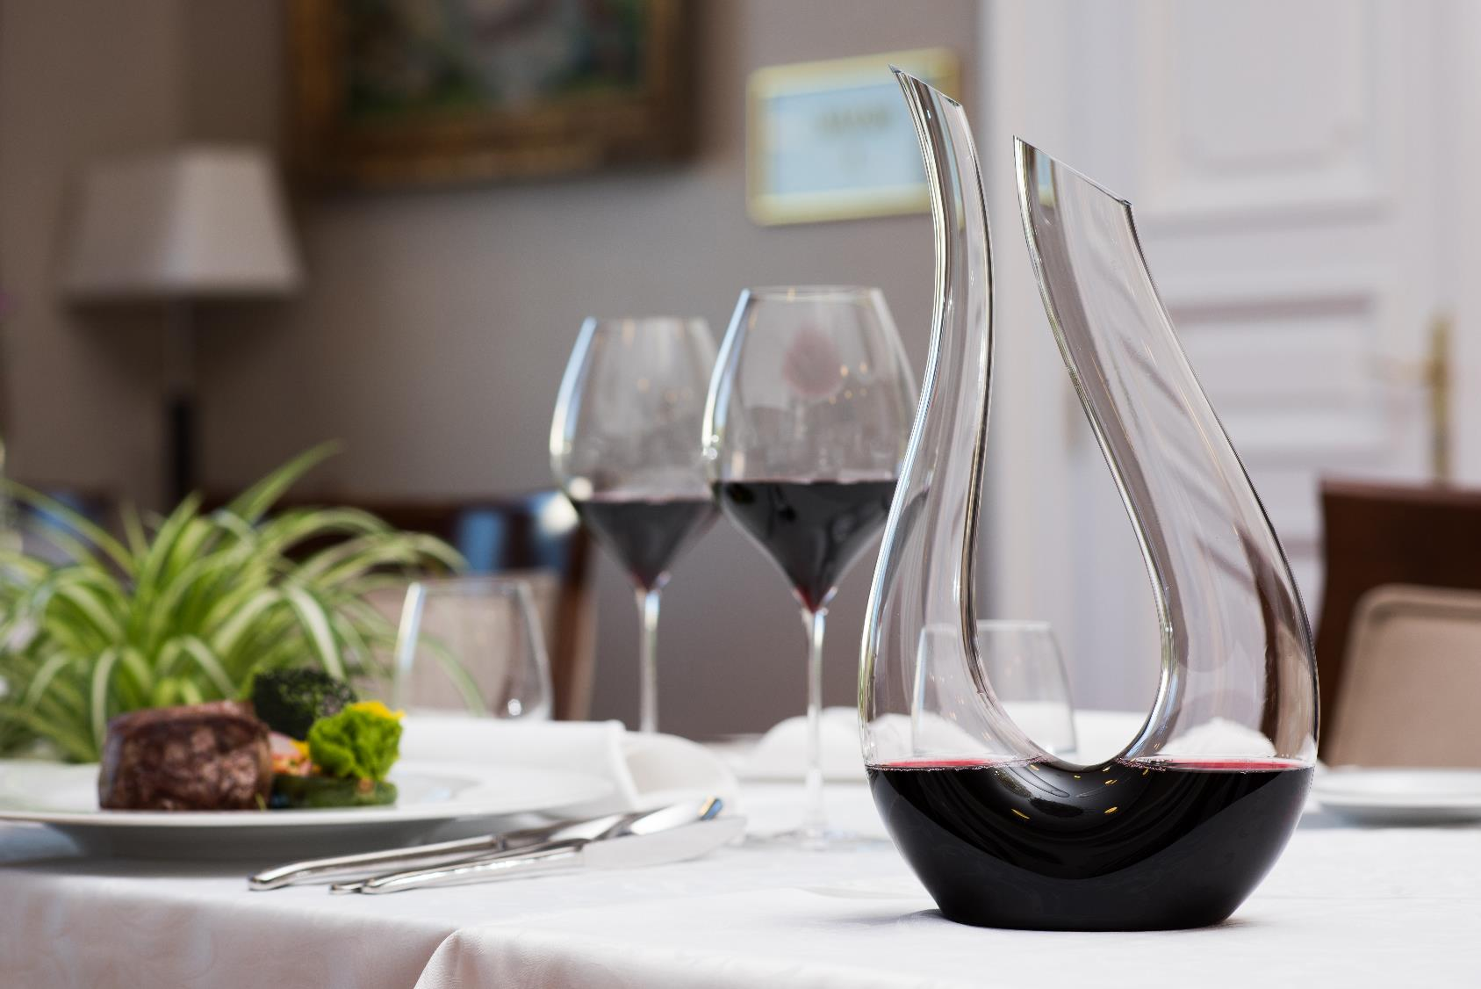
Premium
Our handmade lead free cristaline products are individually crafted by glassmakers with decades of experience.
RONA PREMIUM concept is designed to surprise your intimates for birthday or Valentine's day or just adorn your home with an luxurious and essential gift, peculiar for it's clarity and brilliance.

Slide 17
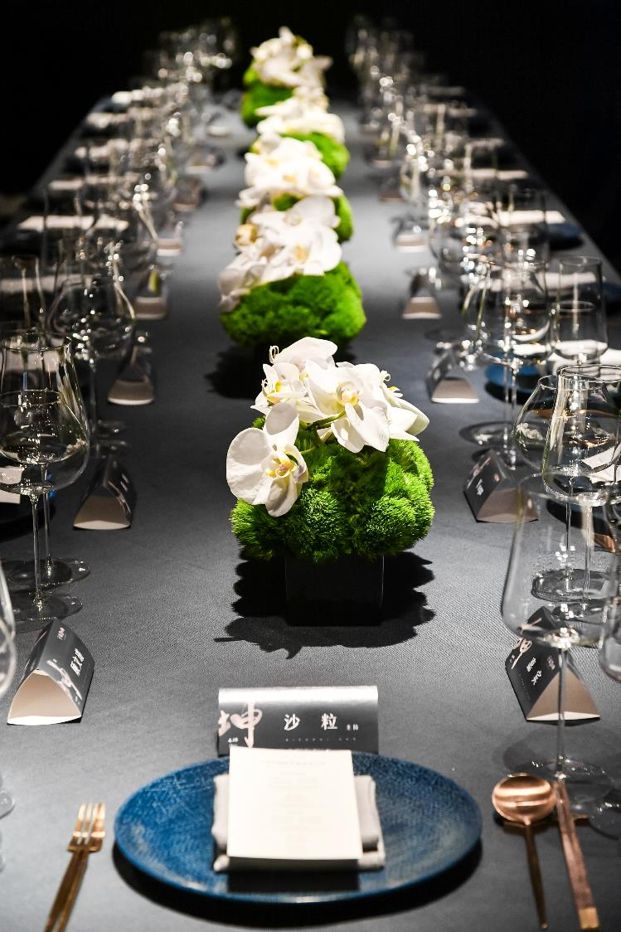
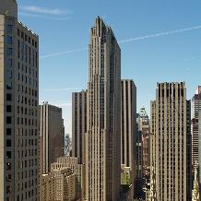
References
New York Rockefeller center’s Rainbow
The glass from Lednické Rovne can be found in the New York Rockefeller center’s Rainbow Room, and in luxury hotels in Dubai and Las Vegas.
Emirates, Etihad, KLM, American Airlines, ...
The glass from the RONA company is supplied to airlines including: Emirates, Etihad, KLM, and American Airlines.
Buckingham palace & White House Product of the company can by found at Buckingham palace and the White House.

Slide 18
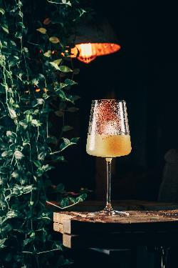
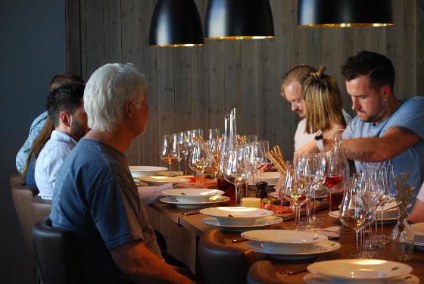
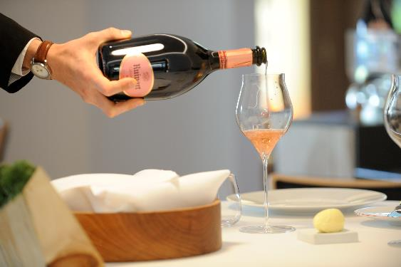
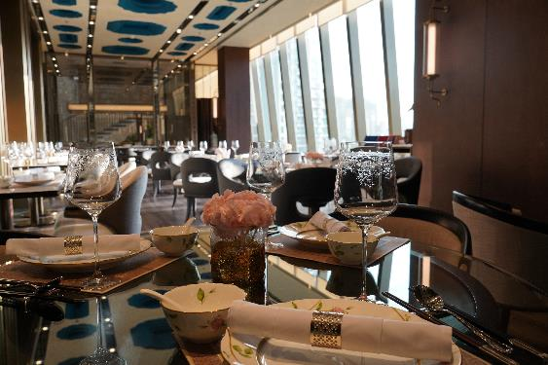
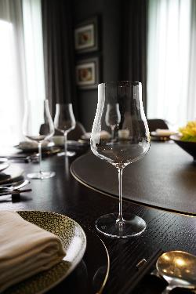
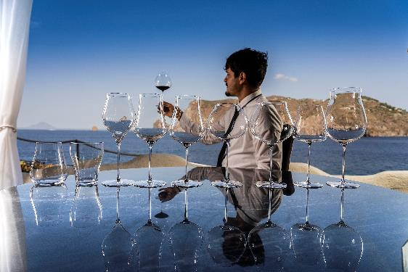
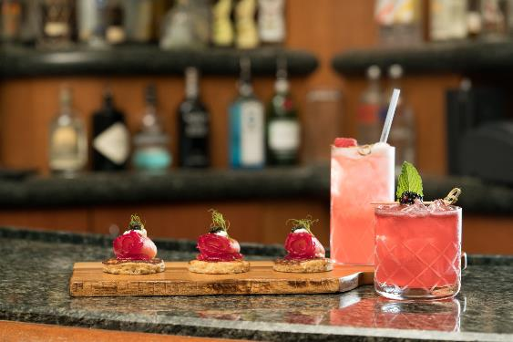
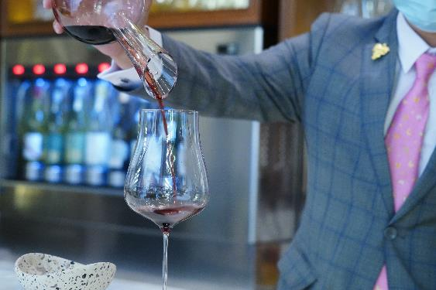
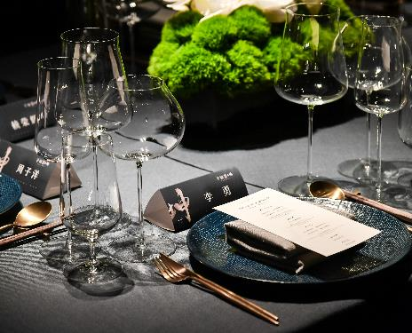
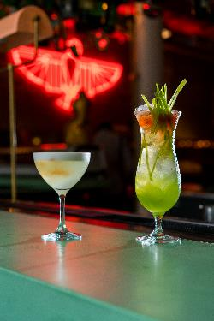
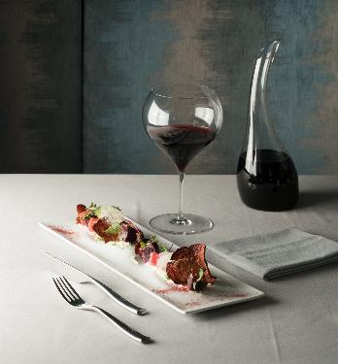
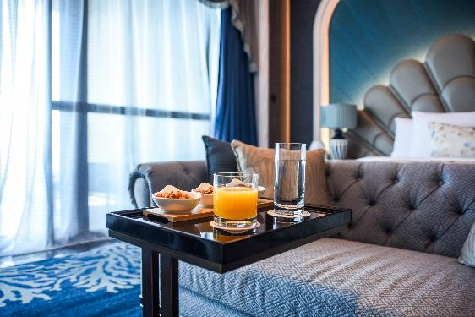
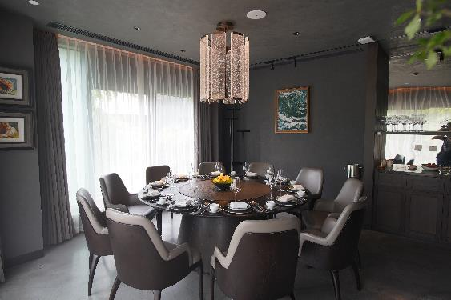
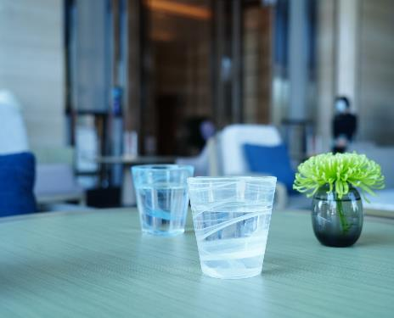
... and a lot more

Slide 19
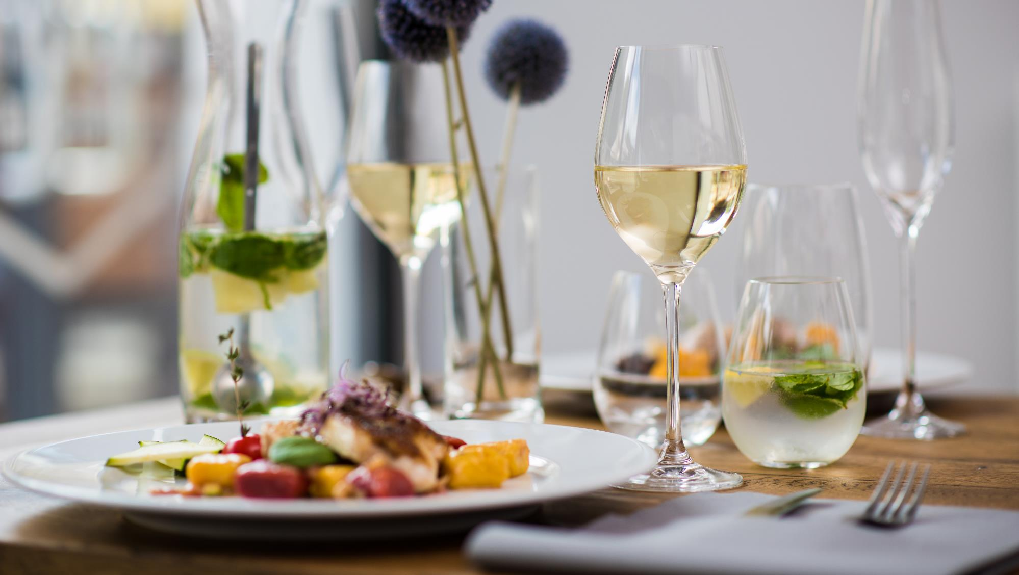
Thank you for your kind attention.

