Slide 1
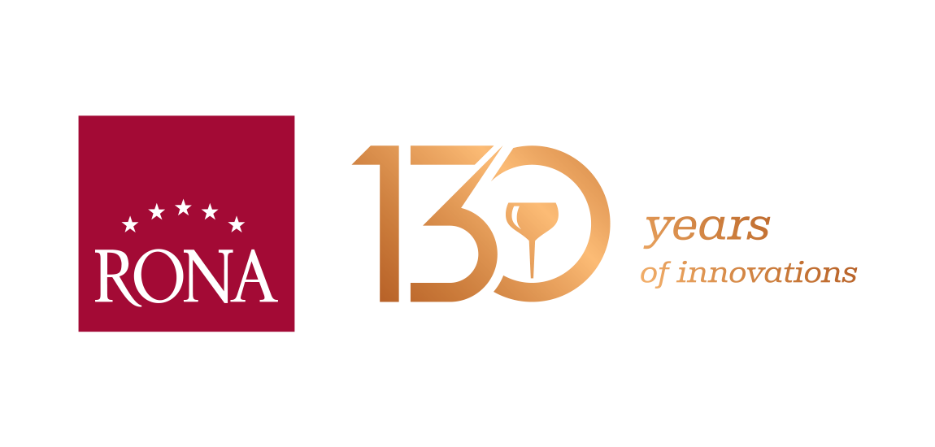
RONA Presentation 2022
About company
www.rona.glass
01.01.2022

Slide 4
“RONA’s production is exported to and available in over 80 countries world wide.”

Slide 5
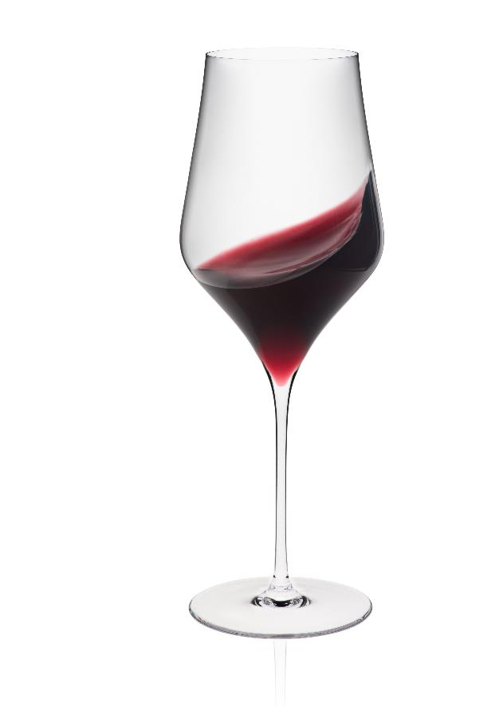
GENERAL INFORMATION
Company with a strong export position, qualified staff and cutting edge technology.
One of the world's leading and largest manufacturers of nonlead household crystalware.
Annual turnover of EUR 70,9 million (2021).
Company with long tradition and experience – it was founded in 1892 in Lednicke Rovne , Slovakia in the area where families worked at the glassworks for generations.
Current number of employees is 1300.
Machine-made stemware and drinkware representscore position in the company's offer and assortment.
Over 96% of RONA's total production is exported to more than 80 countries worldwide and this figure is growing.

Slide 6
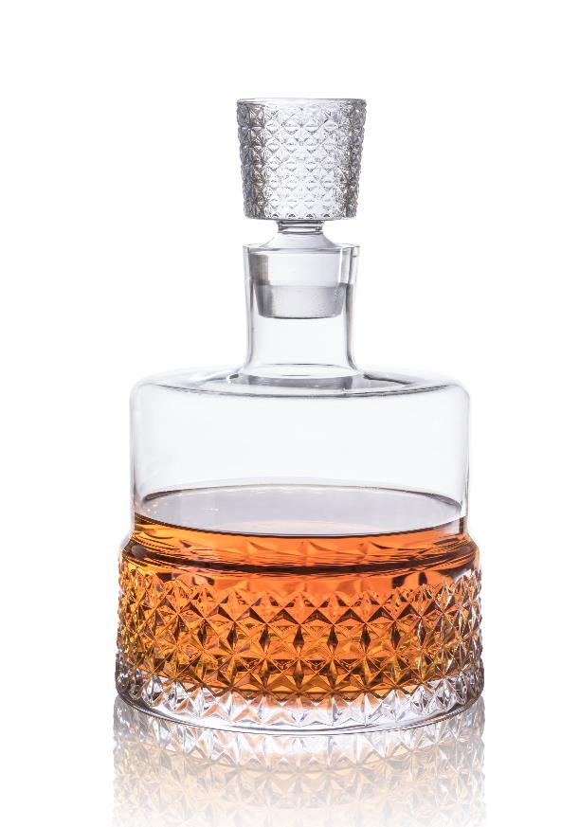
COMPANY DEVELOPMENT – MILESTONES OF THE FACTORY
1892
- foundation of the glassworks by Jozef Schreiber an nephews co. of Vienna
1896
- installation of the pantograph decorating machine, first of its kind in Central Europe
1897
- supplier to important clients and hotels across Central Europe including the renowned Sacher Hotel in Vienna
1942
- Slovenske sklene huty (Slovak glassworks) established as a joint stock independent company
1946
- nationalization of the glassworks and inclusion as part of the Slovak glass conglomerate under the name LR CRYSTAL
1965
- introduction of first automated production
1993
- privatisation of the factory following the changes after the Velvet revolution

Slide 7
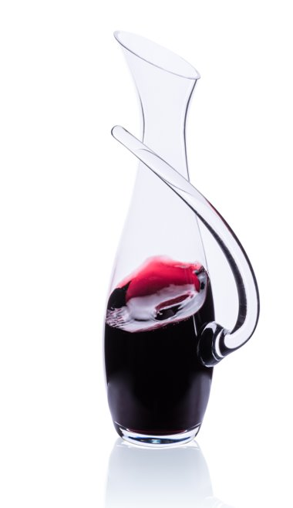
COMPANY DEVELOPMENT – MILESTONES OF THE FACTORY
2001
- change of the brand name to RONA
- installation of advanced technology for automated production of pulled stemware
2012
- RONA celebrates its 120th anniversary
2017
- RONA celebrates its 125th anniversary
2018
- introduction of ultrathin machine made technology with qualities of handmade production

Slide 8
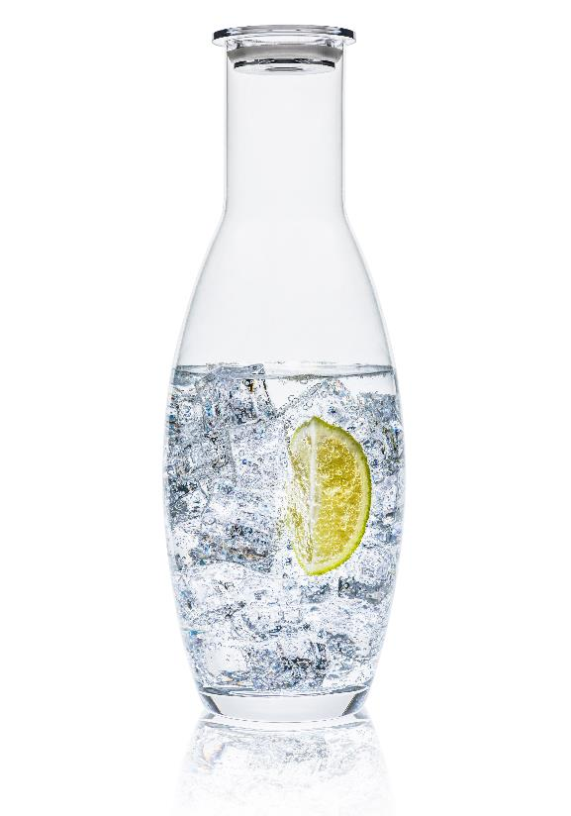
MACHINERY AND PRODUCTION TECHNOLOGIES UTILIZED
GLASS BLOWING MACHINES PRODUCING:
stemware with pulled stems
ultrathin machine made stemware
stemware with attached stems
large accessory pieces such as vases, bowls and carafes
tumblers, drinkware
HAND MADE:
handmade workshop producing stemware, tumblers and accessories
The same cristalline glass compostions is used for both machine made and handmade items. RONA's leadfree-crystal blanks are very suitable for all kinds of decorating techniques. RONA does not melt colors.

Slide 9
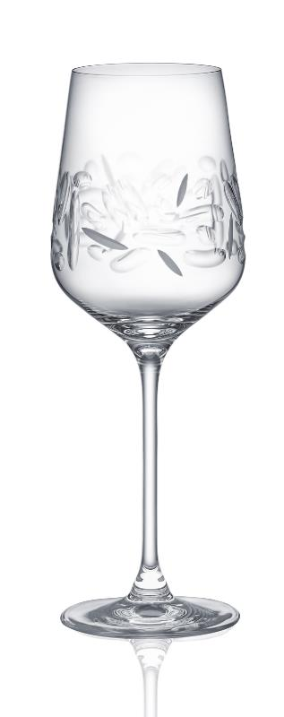
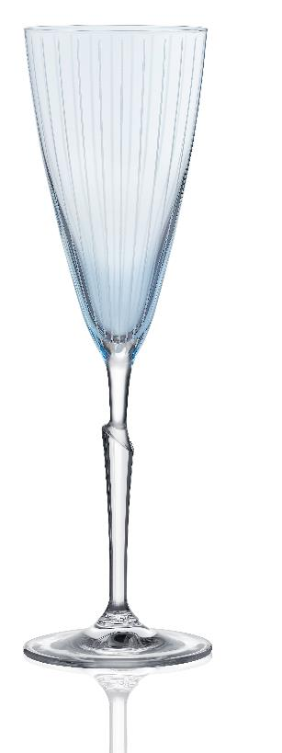
DECORATION TECHNIQUES USED
RONA Glassworks is capable of using an almost unlimited variety of decorating techniques, such as:
pantograph etching
diamond cutting
machine and hand cutting
hand painting of metallic rims (gold and platinum)
hand painting of luster colors
spraying of organic colors
sand blasting
screen printing and applying decals

Slide 10
BUSINESS PLAN AND STRUCTURE
RONA does business with large variety of customers
Our products are presented on the markets under these brands:
Logo RONA (own brand business)
Logo RONA (gastro/HoReCa division)
Private brands (OEM) - tailor made branded products and projects represent major part nowadays. Our own product concept under the name "RONA Select" is available to the customers as well.
RONA foodservice portfolio and deliveries for the gastronomy and airlines segments are respected in the trade world and forms an important part of RONA's production.
Major part of our production i machine made programme, followed with various decorations and hand made assortment.

Slide 11
COMPANY’S MAIN VISION
Our philosophy and strategy is based on the following principles:
“DEVELOPMENT OF LONG TERM
BUSINESS PARTNERSHIP”
&
“CUSTOMER ORIENTED SERVICE REMAINS
OUR FIRST AND TOP PRIORITY”

Slide 12
COMPANY’S BUSINESS GUIDELINES AND STRENGTH
lead free crystal blanks and quality of the products
state – of – the – art machines and technology
"perceived value" of the products
inspired product design and innovation
wide product range and variety of tooling
cooperative attitude, flexibility and finding individual solutions for customers
tradition, knowledge and quality staff
customer oriented service

Slide 13
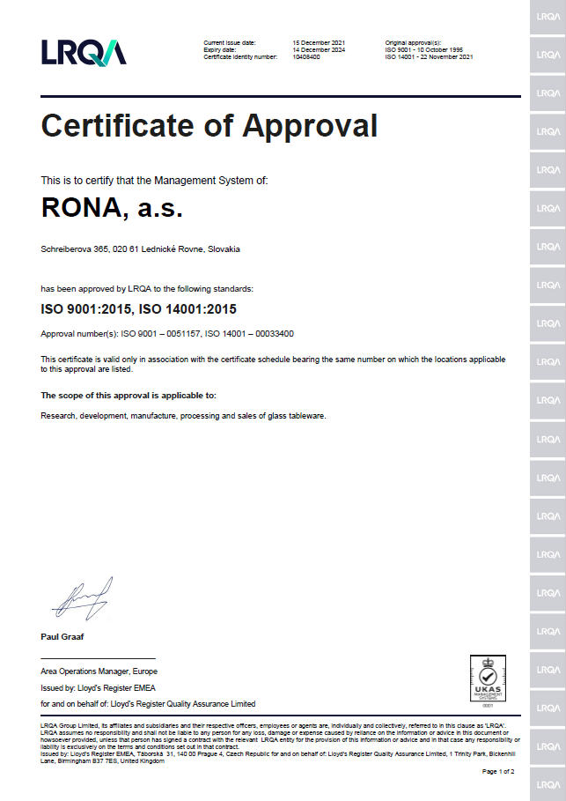
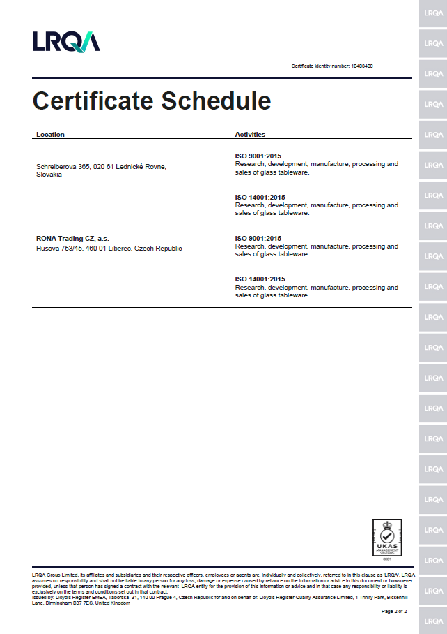
QUALITY MANAGEMENT
RONA FACTORY has been approved by Lloyd’s Register Quality Assurance to the following Quality Management System Standards:
ISO 9001:2008
EN ISO 9001:2008
BS EN ISO 9001:2008
STN EN ISO 9001:2009
Approval Certificate No:
ISO 9001 – 0051157
ISO 14001 - 00033400

Slide 14
COMPANY’S AWARDS AND RONA’S DESIGN TEAM
RONA factory is very active also in the design field.
For its esthetical and art oriented concept the facotry recieved many domestic and international rewards over the past 120 years.
To name just a few we need to metion at least the following awards:
1959 - Corning glass museum New York
1960 - 12th Triennial Milan
1972 – Exempla Munich
In the most recent years these were the awards from the Ambiente fair in Frankfurt.
The year 2006 the Award "DESIGN PLUS" Germany
The year 2008 the Award “FORM” Germany
2014 - Shanghai, CHINA – Daily use articles trade fair (CDAFT) - award for the BEST DESIGN

Slide 15
ENVIRONMENTALLY FRIENDLY COMPANY
Glassworks with socially – responsible, sustainable and environmentally friendly business practices.
Special attention is kept to all the requirements with respect to environment and health care, water and air pollution protection, waste disposal programme, preventive measures against serious industry accidents and integrated works /security arrangements etc.
Database of all important certificates and guarantees in place
Examples:
May 2, 2012 - RONA Cristalline glass – Health and Food friendly products, No. Cov – 2012/4/05
Oct 31, 2011 - Testing of glassware according to California Proposition 65.
(The negative results of the lead and cadmium leaching from the products)
May 18, 2009 NATURE - PACK CERTIFICATE NO. 00827
(obligations for waste processing care and recyclability of products and packaging material used)

Slide 16
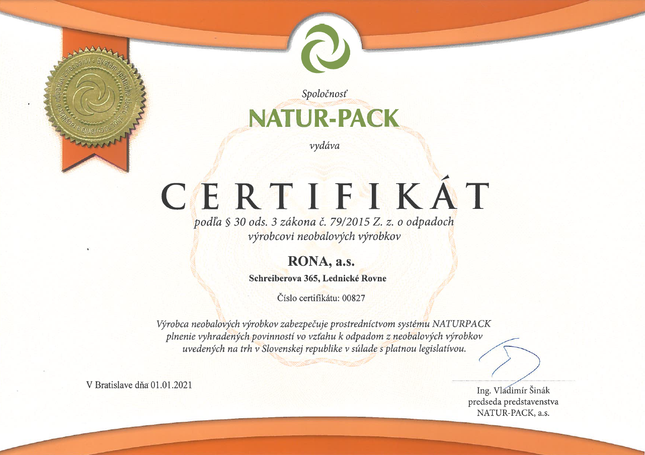
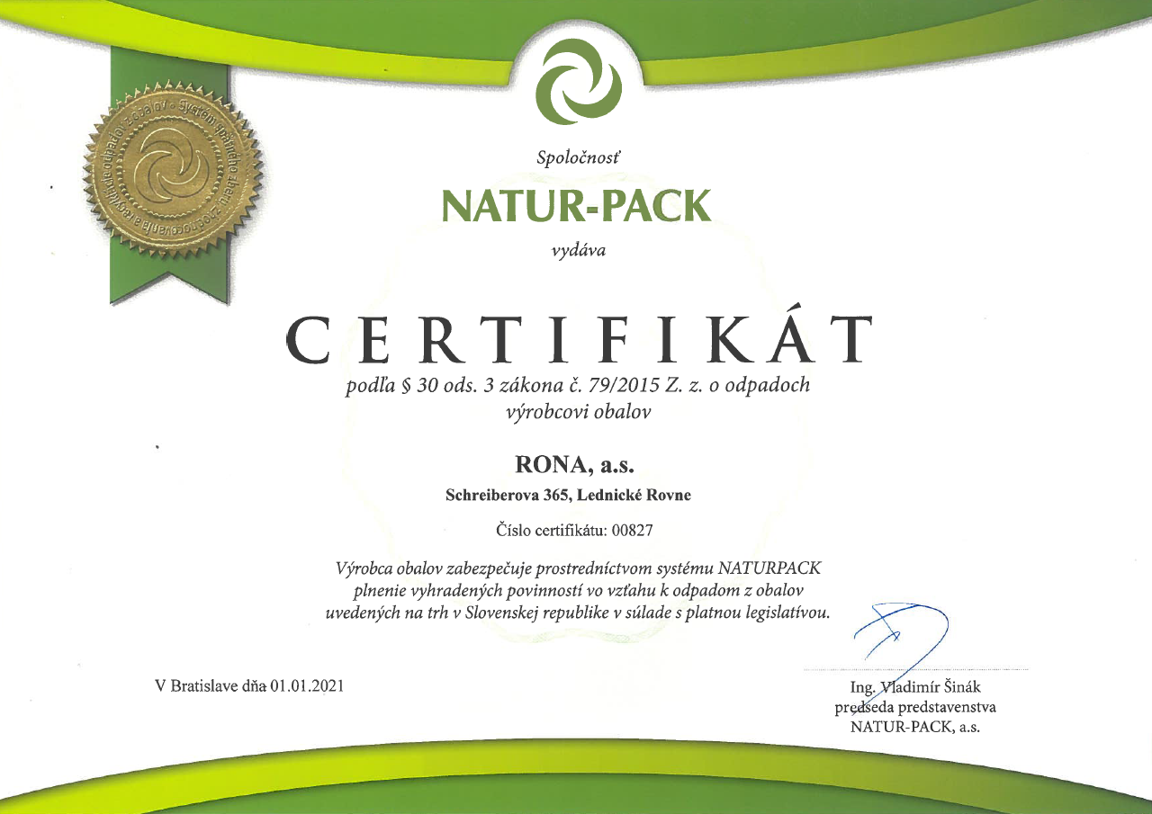
ENVIRONMENTALLY FRIENDLY COMPANY
August 31, 2015 – Certificate of Conformity – No. CN -15A/2015 (cristalline glass product conforming to the regulations of the European Parliament and of the Council, Ministry of Industry and Trade, Ministry of Agriculture )
up to date:
REACH – EUROPEAN REACH LEGISLATION AND STATUS OF RONA’S PRODUCT (JUNE 2013)

Slide 17
CORPORATE SOCIAL RESPONSIBILITY
1. EDUCATION and SCHOOL SYSTEM
glass schools and care for future generations of young glassmakers
2. CULTURE AND ART
preservation of and contribution to the National Slovak Art and Culture heritage
3. SCIENCE AND RESEARCH
cooperation with Slovak Science Academy and runningResearch Joint Centre
4. HEALTH AND SOCIAL WELFARE
care for employees, welfare and health programmein place – (“Healthy Company 2013” certificate)
5. ECOLOGY AND ENVIRONMENTAL SUSTAINABILITY
RONA’s production complies with the EU environmental legislation
RONA – factory with the responsibility to give back to the community

Slide 18
CONTACT
The management and all staff and employees of RONA glassworks co. wish to thank you for your kind attention and we are looking forward to your continuing support, interest and cooperation in the future.
Production plant
HEADQUARTERS & SALES:
RONA, a. s.
Schreiberova 365
SK – 020 61 Lednické Rovne
Slovak Republic
Tel.: +421 424 601 504
Fax: +421 424 601 137
E-mail: sales@rona.sk
www.rona.glass
SALES OFFICE:
RONA Trading CZ, a. s.
Husova 45
CZ – 460 01 Liberec
Czech Republic
Tel.: +420 485 253 711
Fax: +420 485 253 748
E-mail: sales@rona.sk

